Slide 1


Business Reality
Module 12:
Understanding Business vs Personal Money
Delivered by
1

Slide 2
Understanding opportunities, ideas and local entrepreneurship
This programme is about exploring ideas, building confidence and understanding how enterprise can create opportunities in the South of Scotland.
1
What is Pathways?
2
What will you gain?
3
Session Structure
The Pathways Programme by South of Scotland Enterprise (SOSE) is a support initiative designed to help people in the South of Scotland turn their business ideas into reality.
It specifically focuses on women and under-represented groups, helping them overcome the personal and practical barriers that often make starting a business feel overwhelming.
  Confidence & Coaching: Personal support from local coaches to help you move past self-doubt and build the resilience needed to run a business.
  Financial Help: Small grants (up to £1,000) to help pay for start-up essentials like equipment, marketing, or training.
  Community: Connection to a network of other local entrepreneurs so you don’t have to start your journey alone.
  Growth Support: Specialist coaching for those ready to scale up or innovate their existing business.
  Introduction video
  Understanding entrepreneurship
  Regional opportunities
  Case study
  Activity
  Reflection
  Key takeaways
2

Slide 3

Learning Objectives
By the end of this module you will:
1
Understand the difference between personal and business money and why keeping them separate matters
Explore how businesses track income, expenses, and profit to make informed decisions
Understand why saving for tax and staying organised helps reduce stress
Identify simple tools and habits that can help you manage your business money effectively
2
3
4
Why does knowing about money matter?
3

Slide 4
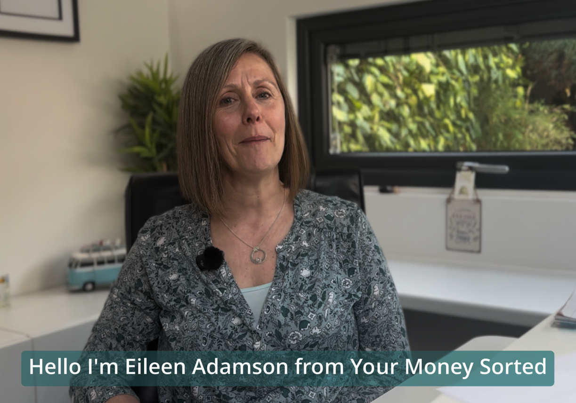
Video Task:
Watch the video below and take notes.
4
Notes:
Video embedded

Slide 5
Beyond the Bank Balance
The Big Question: Why do you think businesses need to understand their money?
It turns an "idea" into a sustainable "reality."
Knowing your numbers helps you make better decisions.
It builds the resilience needed to run a business.
Discuss: What worries you most about business money?
5

Slide 6
Practice the Split
The Scenario: You just earned £200 from a sale.
Tax (20%) = £
Expenses (Costs): What did it cost to make/run?
Profit: What is left for you?
6

Slide 7
Saving for Tax
The 20% Rule
The Concept: For every pound that comes in, 20p isn't yours; it’s the Tax Man’s.
Why Save Monthly?
Avoid a massive, stressful bill at the end of the year.
You always know exactly what your "real" profit is.
Professionalism: You are treating your business like a real entity.
7

Slide 8
Tax Calculations
Task: Calculate the 20% set-aside for these earnings:
£100 Earnt →
£250 Earnt →
£500 Earnt →
Formula Reminder: Earnings x 0.20 = Tax Pot.
8

Slide 9
Keeping Receipts
Why Keep Them?
To prove your Business Costs.
To pay the correct amount of tax (and not a penny more!).
To stay organised for your "Money Date."
Pro-Tip: Take a photo of a receipt the second you get it.
9

Slide 10
Work Smarter, Not Harder
Automation: Use tools that link directly to your bank feed.
The Line-up:
Hubdoc / DEXT: Great for capturing receipts via your phone camera.
FreeAgent / Sage: Full bookkeeping software that tracks profit and loss automatically.
Benefit: Saves you time, which is a hidden cost of business!
10

Slide 11
Bookkeeping?
Simple Definition: The process of recording all financial transactions, every penny in, every penny out.
Why it matters:
You can’t calculate profit without knowing your total costs.
It shows you the "win" in your pocket.
11

Slide 12
The Monthly Money Date
It’s about the ‘Habit Over Hassle’
The Concept: A dedicated time once a month to "date" your finances.
Your Checklist:
  Did I record all my income?
  Did I log all my expenses/costs?
  Is my 20% Tax Pot up to date?
  How much profit did I actually make?
12

Slide 13
Zone of Genius and Asking for Help!
Discussion: What are you naturally good at? (e.g., Making cheesecakes, marketing, talking to customers).
The Reality: You don't have to be an accountant to be a great business owner.
Identify: Which money tasks feel easy? Which ones feel heavy?
Building Your Support Network:
Bookkeepers: To handle the day-to-day data.
Accountants: For end-of-year tax filing.
Mentors/Coaches: For financial confidence and coaching.
Friends/Peers: To stay accountable for your "Money Dates.
13

Slide 14
Learning Objectives
Let’s Recap:
1
Understand the difference between personal and business money and why keeping them separate matters
Explore how businesses track income, expenses, and profit to make informed decisions
Understand why saving for tax and staying organised helps reduce stress
Identify simple tools and habits that can help you manage your business money effectively
2
3
4
14

