Slide 1


Building Your Business
Module 8:
Using Digital Tools
Delivered by
1

Slide 2
Understanding opportunities, ideas and local entrepreneurship
This programme is about exploring ideas, building confidence and understanding how enterprise can create opportunities in the South of Scotland.
1
What is Pathways?
2
What will you gain?
3
Session Structure
The Pathways Programme by South of Scotland Enterprise (SOSE) is a support initiative designed to help people in the South of Scotland turn their business ideas into reality.
It specifically focuses on women and under-represented groups, helping them overcome the personal and practical barriers that often make starting a business feel overwhelming.
  Confidence & Coaching: Personal support from local coaches to help you move past self-doubt and build the resilience needed to run a business.
  Financial Help: Small grants (up to £1,000) to help pay for start-up essentials like equipment, marketing, or training.
  Community: Connection to a network of other local entrepreneurs so you don’t have to start your journey alone.
  Growth Support: Specialist coaching for those ready to scale up or innovate their existing business.
  Introduction video
  Understanding entrepreneurship
  Regional opportunities
  Case study
  Activity
  Reflection
  Key takeaways
2

Slide 3

Learning Objectives
By the end of this module you will:
1
Explore how businesses use social media to help people find and connect with their ideas.
Understand how setting goals and knowing your audience helps guide content creation.
Identify apps, platforms, and tools that businesses use every day.
Begin creating your own social media ideas to support your business goals.
2
3
4
Image by: Canva Mockups
What is a content strategy?
3

Slide 4
Content Strategy
A content strategy means:
  Planning what you post
  Thinking about your audience
  Posting with purpose
Why is planning content helpful?
Think about:
  What will you post?
  When will you post?
  Why are you posting it?
Kirsty Video - Planning Content
4

Slide 5
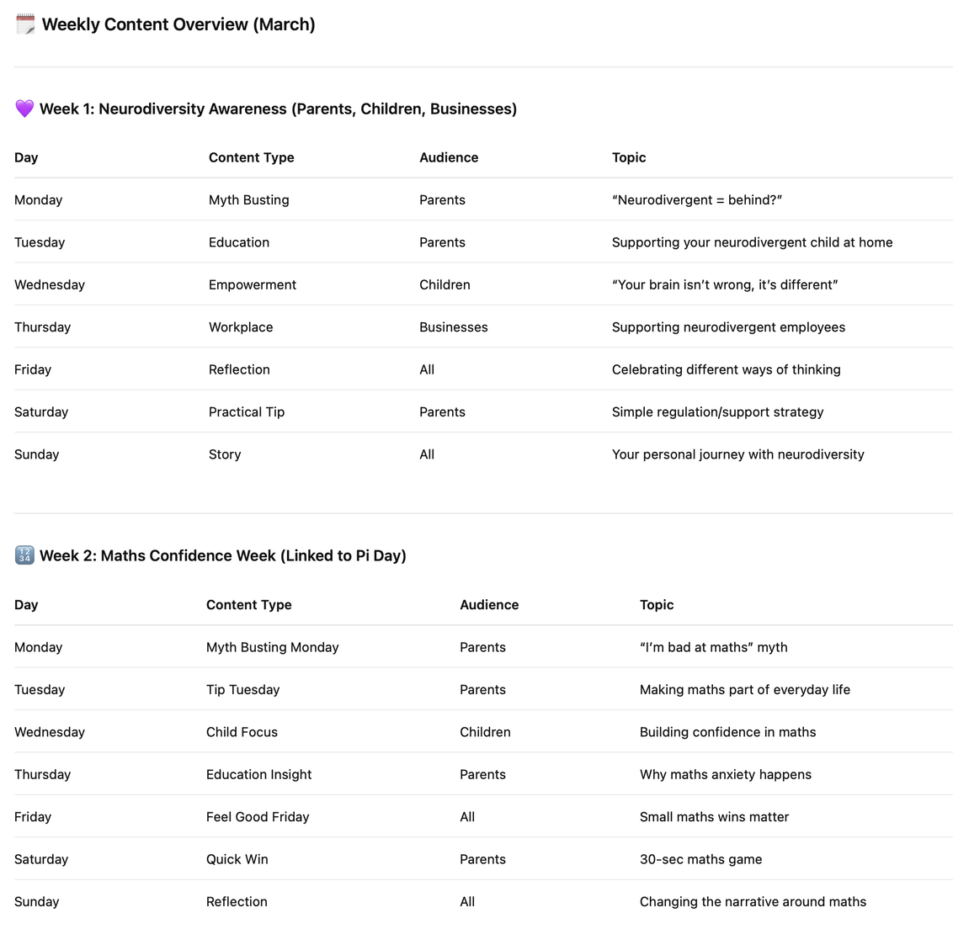
Take a look at this content planner from Kindling Minds.
What stands out to you? What do you notice?
Tools that help:
There are many tools we can use to help us create posts, here are a few:
  Canva,
  Meta Schedule Planner
  Buffer
  Metricool
  Notion
  Tiktok Studio Planner
  and many more...
5

Slide 6

Scheduling Posts
Kindling Minds has screen recorded a post upload for their social media pages.
While watching the video, look carefully at what is happening.
Think about:
• What tools are being used
• How the post is created
• How it is scheduled
6

Slide 7
Video Observations
In your workbook, answer the following questions:
✏️ Task 6: What did you notice?
Write down:
• One tool that was used
• One step in creating the post
• One step in scheduling the post
✏️ Part 2: Understanding the Process
☐ AI was used (e.g. captions or ideas)
☐ A specific platform was used (e.g. Instagram, Canva)
☐ The post was planned before being shared
☐ The post was scheduled for later
(Add anything else you noticed)
✏️ Task 7: Thinking Like a Business Owner
Answer:
• Why do you think planning and scheduling posts is helpful?
• What do you think this business is trying to achieve with this post?
✏️ Part 2: Your Ideas
If this was your business…
• What would you keep the same?
• What would you do differently or improve?
7

Slide 8
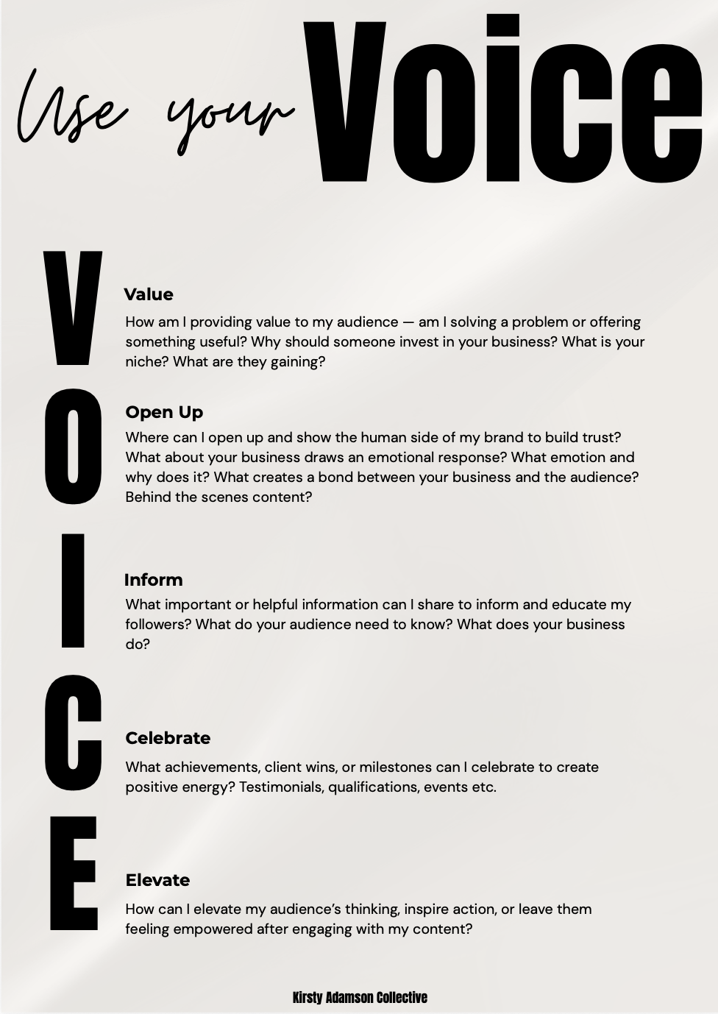

Your Turn
Think of your business idea... Your task is to create a content planner for a week in your workbook.
Use the V.O.I.C.E method by Kirsty, Social Media Manager based in Dumfries to help strategically plan your content for the week.
8

Slide 9
Learning Objectives
Let’s Recap:
1
Explore how businesses use social media to help people find and connect with their ideas.
Understand how setting goals and knowing your audience helps guide content creation.
Identify apps, platforms, and tools that businesses use every day.
Begin creating your own social media ideas to support your business goals.
2
3
4
9
Notes:
Guide participants to the end survey, that will allow them to see progress they have made.

