Slide 1


Understanding your Idea
Module 3:
Identifying Problems & Opportunities
Turning Everyday Problems Into Business Ideas
Delivered by
1

Slide 2
Understanding opportunities, ideas and local entrepreneurship
This programme is about exploring ideas, building confidence and understanding how enterprise can create opportunities in the South of Scotland.
1
What is Pathways?
2
What will you gain?
3
Session Structure
The Pathways Programme by South of Scotland Enterprise (SOSE) is a support initiative designed to help people in the South of Scotland turn their business ideas into reality.
It specifically focuses on women and under-represented groups, helping them overcome the personal and practical barriers that often make starting a business feel overwhelming.
  Confidence & Coaching: Personal support from local coaches to help you move past self-doubt and build the resilience needed to run a business.
  Financial Help: Small grants (up to £1,000) to help pay for start-up essentials like equipment, marketing, or training.
  Community: Connection to a network of other local entrepreneurs so you don’t have to start your journey alone.
  Growth Support: Specialist coaching for those ready to scale up or innovate their existing business.
  Introduction video
  Understanding entrepreneurship
  Regional opportunities
  Case study
  Activity
  Reflection
  Key takeaways
2

Slide 3

Learning Objectives
By the end of this module, you will:
1
Understand how business ideas often start from everyday problems
Learn to spot frustrations and challenges in daily life
Explore the difference between needs and wants
Begin turning problems into possible business ideas
2
3
4
Image created by Canva AI
What does this picture make you think of?
3

Slide 4
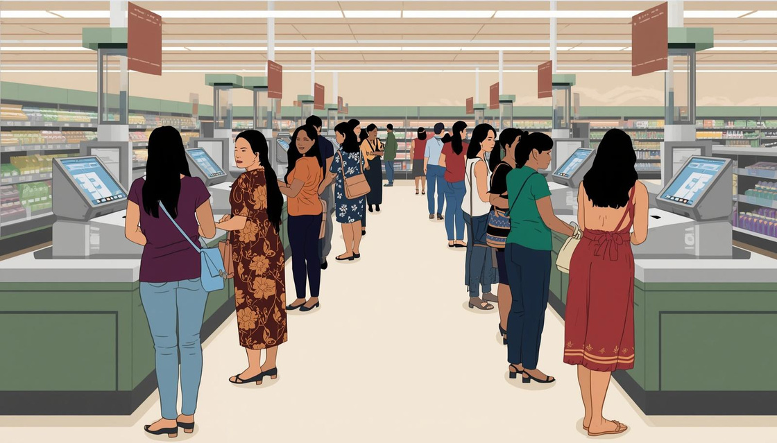
What things annoy you everday?
Some examples based in the South of Scotland could be:
  Long queues
  Slow WiFi
  Expensive food
  Lack of things to do locally
  Transport issues
  Lack of shops
Write down up to 5 daily annoyances you have.
Image created by Canva AI
4

Slide 5
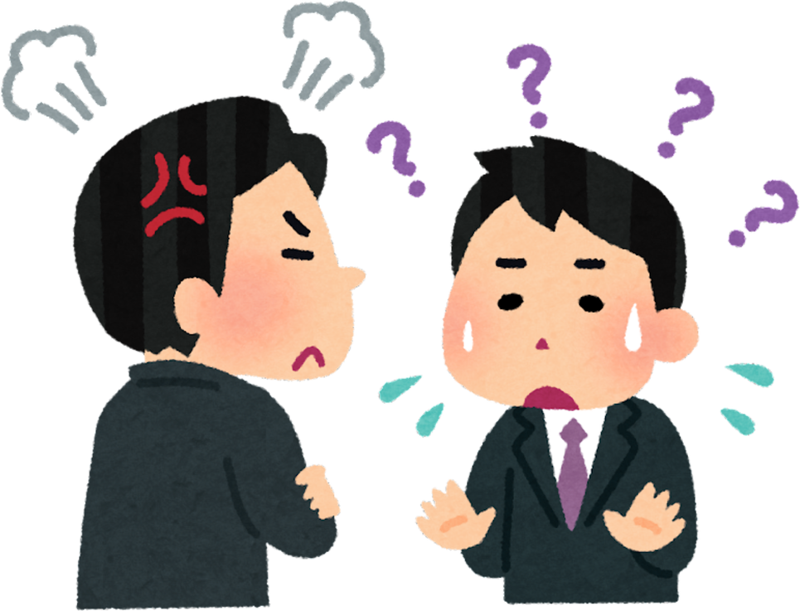
Complaints = Opportunities
Many successful businesses started because someone thought:
“There must be a better way to do this.”
Examples:
• Uber → taxis were difficult to access
• Airbnb → hotels were expensive or unavailable
• Deliveroo → restaurants didn’t deliver
What examples can you think of? Discuss at your table.
5

Slide 6
The Business Idea Is Already Around You...
As you watch the video, think about:
  What problem was identified?
  How did someone turn it into a business idea?
6
Notes:
Video embedded

Slide 7



Real examples
Every complaint could be a buisness idea...
As a group, discuss the entrepreneurs you heard from.
  What problems did the entrepreneurs notice?
  Why do you think these ideas worked?
  Did the problem affect lots of people?
Complete the task in your workbook.
Be ready to share one key insight with the room.
7

Slide 8
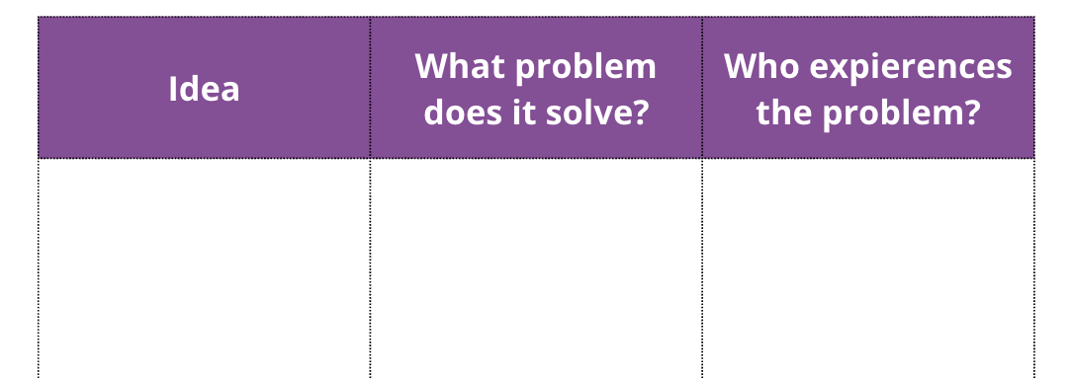
Find your Answers
Around the room you will find cards with different pieces of information:
• a business idea
• the problem it solves
• who experiences the problem
Your task is to find the two cards that match yours.
Step 1
Look at the card you have been given.
Decide whether it shows:
• an idea
• a problem
• or who experiences the problem
Step 2
Move around the room and talk to other participants to find the two cards
that complete your set.
Example:
Idea: Dog walking service
Problem: Busy people don’t have time to walk their dogs
Who experiences it: Dog owners who work long hours
Step 3
Once you find your matching group of three:
Write the full set in your workbook.
Step 4
After recording your answer, separate again and find a new group to create another full set.
Try to complete as many sets as you can.
8

Slide 9

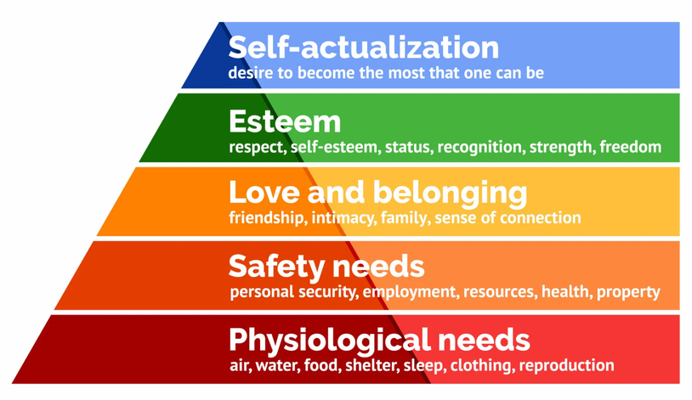
Needs
vs
Wants
The Must-Haves
The Nice-to-Haves
These are the non-negotiables.
If you don't pay for these, there are immediate, negative consequences to your:
  health,
  safety, or
  ability to function in society
(e.g., groceries, rent/mortgage, basic utilities, transportation to school/work).
These are things that enhance your life but aren't required for survival.
If you don't get them, you might be bored or disappointed, but you’ll be okay
(e.g., gaming setups, designer clothes, eating out, concert tickets).
Maslow’s Hierarchy of Needs
9

Slide 10
Task 8: Maslow’s Hierarchy of Needs
Work with a partner.
You will need:
• sticky notes
• a pen or pencil
• a highlighter
Step 1 – Brainstorm (2 minutes)
Together, write down as many examples as you can think of that might be:
• Needs – things people require to live or feel safe
• Wants – things people enjoy but do not need
Write one idea per sticky note.
Examples: phones, housing, clothing, social media
Try to think of as many examples as possible.
Step 2 – Compare Ideas
After 2 minutes, split up from your partner. Find another pair and compare your answers.
Discuss together:
• Which ideas did you label as needs?
• Which ideas did you label as wants?
You may notice that you disagree on some of the ideas.
For example: Is internet access a want or a need?
Step 3 – Highlight Interesting Differences
Use your highlighter to mark any ideas where groups disagreed or had different opinions. Then write these answers into your workbook.
These are often the most interesting discussions!
10

Slide 11

Local Community Problems
What problems exist in your local community?
Examples:
  Lack of activities for young people
  Transport issues
  Limited food options
  Lack of job opportunities
  Poor internet access
Image by South of Scotland Enterprise
Look back at the ideas you discussed in the Maslow’s Needs and Wants activity.
Choose one problem or issue that people experience in your local community.
Using the table in your workbook to answer these 4 questions:
  What is the problem?
  Who experiences the problem?
  How often does the problem happen?
  What is one possible solution?
11

Slide 12
Entrepreneur Thinking
You are now going to think like an entrepreneur. Before writing in your workbook, we will first create a Complaint Wall.
Problem
Idea
Test
Improve
Student’s can’t find food late at night.
Late-night delivery
Start with one small area
Expand menu and delivery hours
Using sticky notes, write down any complaints you have about your community.
Examples might include: Buses are unreliable, nothing to do at night, slow internet, nowhere to meet friends, expensive food.
Write as many complaints as you can. You will have 2–3 minutes.
All the complaints will be placed together on a wall (or visible space). Look through the complaints and choose one problem that interests you.
Using your workbook, complete the ‘Think Like an Entrepreneur’ Activity:
Use the Problem → Idea → Test → Improve framework on your chosen problem.
12

Slide 13

Learning Objectives
Let’s Recap:
1
Understand how business ideas often start from everyday problems
Learn to spot frustrations and challenges in daily life
Explore the difference between needs and wants
Begin turning problems into possible business ideas
2
3
4
13

