Slide 1


Building Your Business
Module 10:
Using AI for Business Ideas & Productivity
Delivered by
1

Slide 2
Understanding opportunities, ideas and local entrepreneurship
This programme is about exploring ideas, building confidence and understanding how enterprise can create opportunities in the South of Scotland.
1
What is Pathways?
2
What will you gain?
3
Session Structure
The Pathways Programme by South of Scotland Enterprise (SOSE) is a support initiative designed to help people in the South of Scotland turn their business ideas into reality.
It specifically focuses on women and under-represented groups, helping them overcome the personal and practical barriers that often make starting a business feel overwhelming.
  Confidence & Coaching: Personal support from local coaches to help you move past self-doubt and build the resilience needed to run a business.
  Financial Help: Small grants (up to £1,000) to help pay for start-up essentials like equipment, marketing, or training.
  Community: Connection to a network of other local entrepreneurs so you don’t have to start your journey alone.
  Growth Support: Specialist coaching for those ready to scale up or innovate their existing business.
  Introduction video
  Understanding entrepreneurship
  Regional opportunities
  Case study
  Activity
  Reflection
  Key takeaways
2

Slide 3
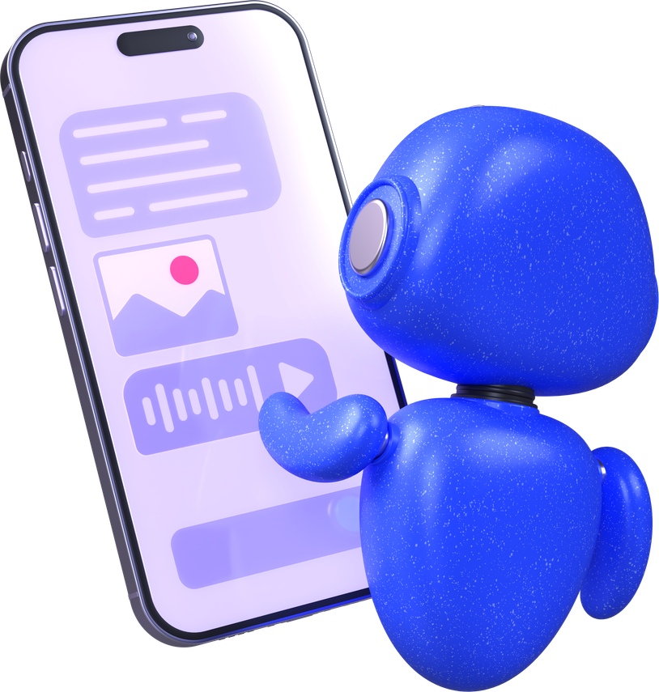
Learning Objectives
By the end of this module you will:
1
Understand how AI can support your business and work more effectively
2
Understand how to use AI safely and effectively to boost productivity
Image by: Canva
3
Be able to use AI to generate ideas, improve your work and create content for your business
4
Feel more confident using AI as a tool to support your ideas, make decisions and improve your work
What do you use AI for at the moment?
3

Slide 4
Safe Uses of A.I in Business
  Brainstorming & Drafting: Use AI to beat "blank page syndrome". It’s brilliant for generating 10 ideas for a social media campaign or drafting a polite email to a customer.
  Routine Tasks: Let AI handle the "donkey work", such as summarising long meeting minutes, organising schedules, or categorising customer feedback.
  Enterprise-Grade Tools: Only use AI tools that are "Private" or "Enterprise" versions. This ensures that the data you type in stays inside the business and isn't used to train the public model (Co-pilot has this built in to their AI model).
  Human-in-the-Loop: Always have a human review AI work before it goes live. AI handles the speed; humans handle the "vibe check", accuracy and most importantly, correct information.
  Coding & Debugging: Use AI to find errors in code or suggest more efficient ways to build a website, provided the code isn’t a top-secret trade secret.
4

Slide 5

Unsafe Uses of A.I in Business
  The "No Ownership" Trap: If you use 100% AI-generated images or text for your brand without changing them, anyone can legally steal them. You can't sue for copyright if a human didn't create the work.
  GDPR & Data Leaks: Putting customer names or private emails into a public AI is a breach of the Data (Use and Access) Act 2025. It’s like leaving the office safe wide open on the street.
  The "Copycat" Risk: Some AI models were trained on "pirated" data. If your AI generates something that looks exactly like a Disney character or a famous artist's work, you could be sued for infringement.
  August 2026 Deadlines: If your business deals with the EU, you must label AI content (e.g., "Generated by AI"). Failure to do this by August 2026 can lead to massive fines.
  Hallucinations in "High Stakes": Never use AI for legal, medical, or financial advice. In 2026, courts are holding businesses personally responsible for AI mistakes.
5

Slide 6
So how do we use A.I well and safely?
Good AI use includes:
• Clear instructions
• Giving context
• Checking answers
• Editing results
Watch the video and make notes of:
  Bad practice
  Good practice
  Changes you would make
  Identify why the critique made suggestions
6

Slide 7
Improving reliability with prompts
In your workbook choose one of the prompts below and re-write the prompt to get a better result!
Write me an email marketing campaign about a new pizza I am launching.
Create 3 social media posts on a new menu item.
Remember to consider:
• More detail
• Clear goal
• Target audience
• Tone or style
Create an image I can use as a background for a product launch.
I want to know when my audience is online.
7

Slide 8
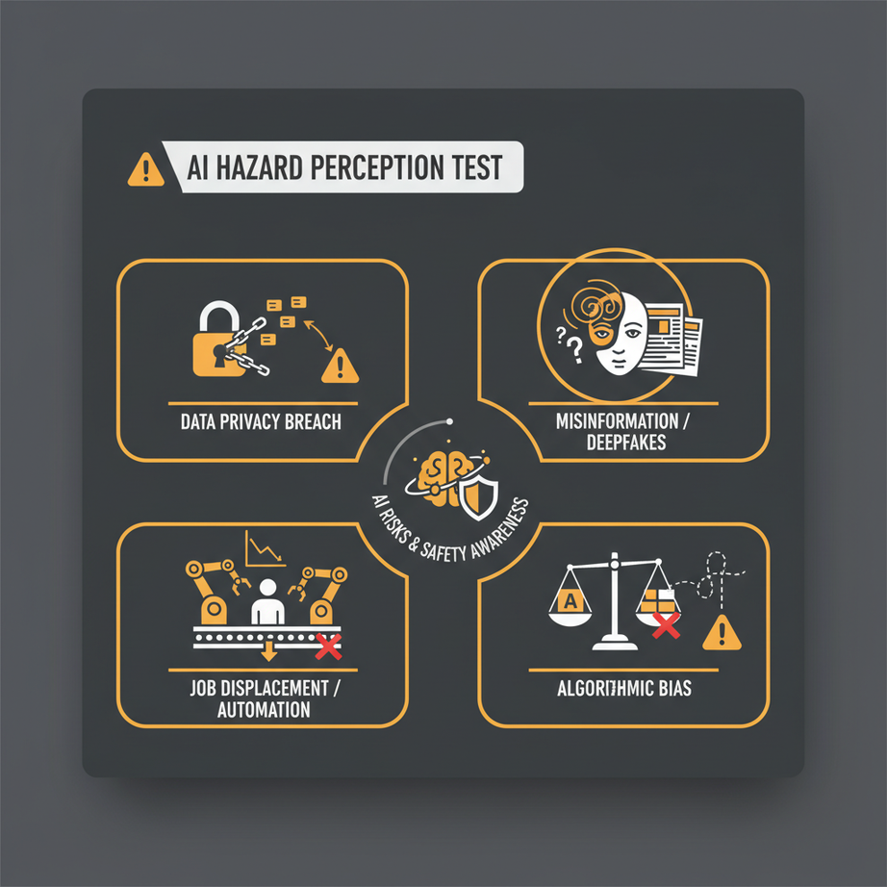
AI Hazard Perception
Sort the sentences into two categories:
SAFE
UNSAFE
Image created by: NanoBanana
8

Slide 9

AI Reflection
In your workbook answer the following questions:
  Using AI safely means...
  Using AI responsibly means...
  I didn’t realise AI .....
  I could use AI for my business by....
  I should not use AI for....
  One thing I understand more about AI...
9

Slide 10
Learning Objectives
Let’s Recap:
1
Understand how AI can support your business and work more effectively
2
Understand how to use AI safely and effectively to boost productivity
3
Be able to use AI to generate ideas, improve your work and create content for your business
4
Feel more confident using AI as a tool to support your ideas, make decisions and improve your work
10

