Slide 1


Building Your Business
Module 6:
Sustainable & Responsible Business
What Kind of Business Do You Want to Build?
Delivered by
1

Slide 2
Understanding opportunities, ideas and local entrepreneurship
This programme is about exploring ideas, building confidence and understanding how enterprise can create opportunities in the South of Scotland.
1
What is Pathways?
2
What will you gain?
3
Session Structure
The Pathways Programme by South of Scotland Enterprise (SOSE) is a support initiative designed to help people in the South of Scotland turn their business ideas into reality.
It specifically focuses on women and under-represented groups, helping them overcome the personal and practical barriers that often make starting a business feel overwhelming.
  Confidence & Coaching: Personal support from local coaches to help you move past self-doubt and build the resilience needed to run a business.
  Financial Help: Small grants (up to £1,000) to help pay for start-up essentials like equipment, marketing, or training.
  Community: Connection to a network of other local entrepreneurs so you don’t have to start your journey alone.
  Growth Support: Specialist coaching for those ready to scale up or innovate their existing business.
  Introduction video
  Understanding entrepreneurship
  Regional opportunities
  Case study
  Activity
  Reflection
  Key takeaways
2

Slide 3

Learning Objectives
By the end of this module you will:
1
Explore what sustainability means in a business context
Understand how businesses impact people, communities, and the environment
Identify values that influence decision making
Learn how businesses can create positive, long-term impact
2
3
4
What kind of business do you want to be known for?
3

Slide 4
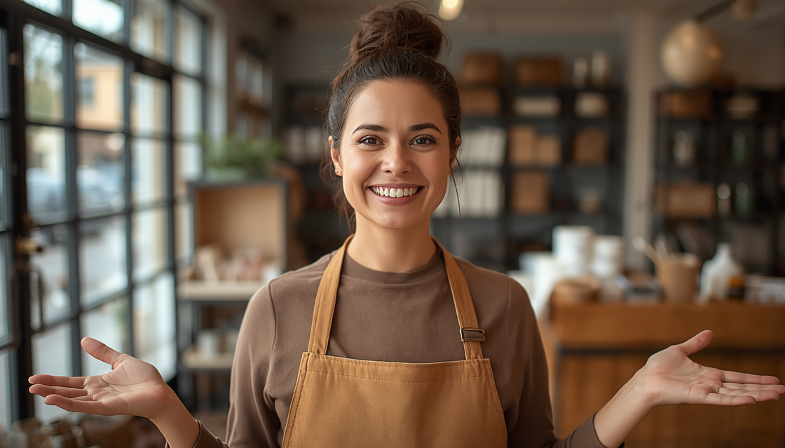
Your Future Business
What do you want to be known for?
  Kind
  Trustworthy
  Affordable
  Local
  Eco-friendly
  Honest
  Reliable
Image by: Canva AI
  What would make you proud of your business?
  What wouldn’t feel right to you?
4

Slide 5
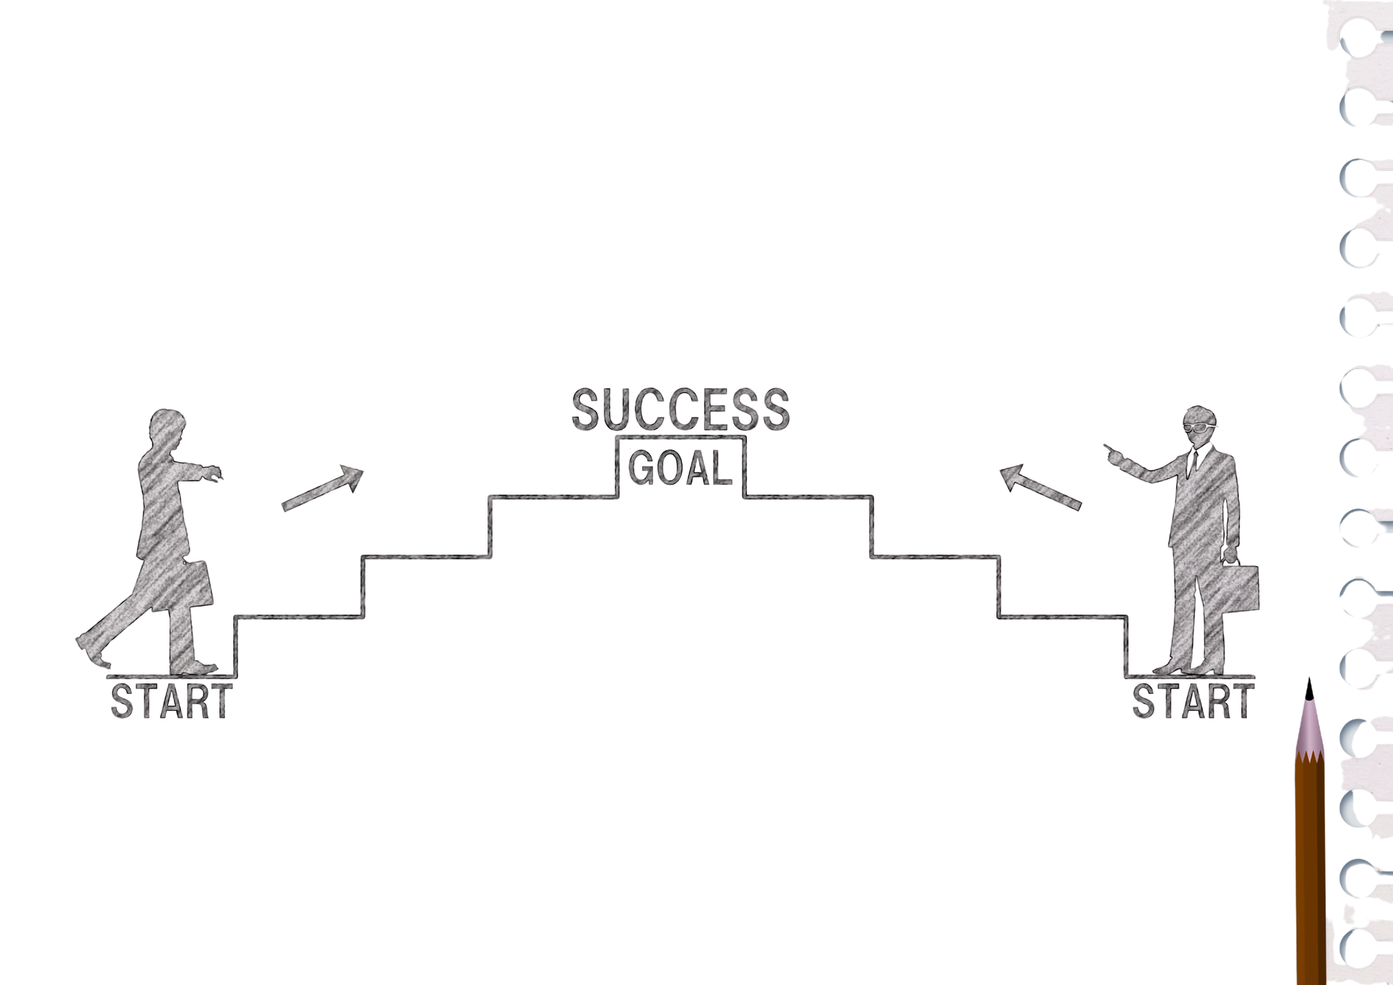
Success isn’t just about money
It’s about:
• The choices you make
• The impact you have
• The reputation you build
To me, a successful business is one that…
5

Slide 6
What is sustainability?
Sustainability means:
  Thinking long-term
  Making responsible choices
  Reducing harm
  Creating positive impact
It’s not just about recycling!
Write one example of sustainability you have seen in real life.
6

Slide 7

The 3 Pillars of Sustainability
People
Planet
Profit
This is the "Social" pillar.
It measures how a business treats its employees, customers, and the community. A "People-first" company focuses on fair wages, safety, diversity, and giving back to the neighbourhood it operates in.
The Goal: To ensure the business is a force for good in society.
This is the "Environmental" pillar.
It tracks the physical footprint a business leaves behind. This includes everything from the energy used in the office to the waste created by packaging and the carbon emitted during shipping.
The Goal: To operate in a way that doesn't deplete the earth’s resources for future generations.
This is the "Economic" pillar.
While every business needs to make money to survive, this definition goes beyond just "getting rich." it’s about sustainable profit; generating enough income to pay workers, reinvest in the company, and stay healthy for years to come.
The Goal: To remain financially stable without compromising the other two pillars.
7

Slide 8

Solway Blankets – Sustainability in Action
Younger Audience:
While watching, write down:
  One thing the business does that is sustainable
  One decision that stood out to you
Older Audience:
While watching, identify:
  A values-driven decision
  A trade-off (e.g. cost vs sustainability)
  Why that decision matters long-term
8

Slide 9
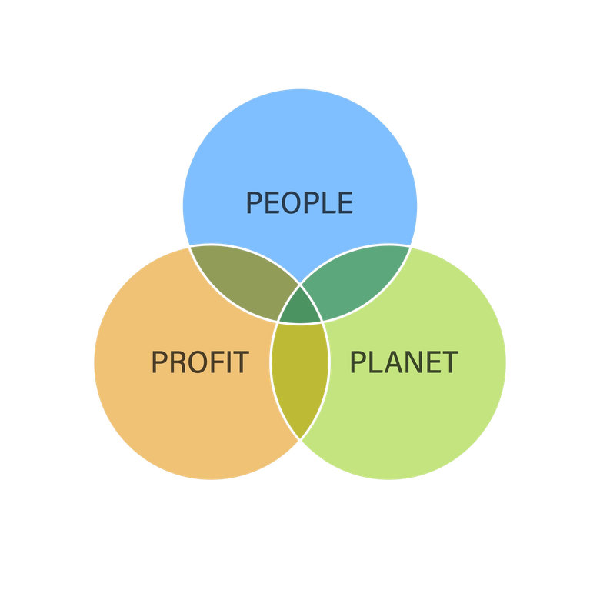
Greenwashing
Greenwashing is a marketing tactic where a company spends more time and money claiming to be "sustainable" or "eco-friendly" than actually doing the hard work to minimize its environmental impact.
Think of it as Mother Nature’s version of a "filter" on social media. The business wants to look green and clean on the outside to attract customers, but behind the scenes, their core practices remain wasteful or harmful. It’s essentially "all talk and no walk."
Workbook Task 10:
Why might a business pretend to be sustainable?
9

Slide 10

Spot the ‘Fluff’
Identify which claim is the "Red Flag" for greenwashing.
  Claim A: "Our sneakers are made from 60% recycled ocean plastic, and you can track the supply chain on our website."
  Claim B: "We are a 'Natural' and 'Earth-First' company!" (Note: There is no data provided, and the packaging is non-recyclable plastic).
  Claim C: "We haven't reached zero emissions yet, but we reduced our carbon footprint by 12% this year by switching to LED warehouses."
10

Slide 11
Learning Objectives
Let’s Recap:
1
I can describe what kind of business I would like to create
I understand that businesses impact people and the world
I can identify choices that reflect positive values
I can explain how a business can make a difference
2
3
4
11

