Slide 1


Business Reality
Module 13:
Resilience & Learning from Failure
What happens when things don’t go to plan?
Delivered by
1

Slide 2
Understanding opportunities, ideas and local entrepreneurship
This programme is about exploring ideas, building confidence and understanding how enterprise can create opportunities in the South of Scotland.
1
What is Pathways?
2
What will you gain?
3
Session Structure
The Pathways Programme by South of Scotland Enterprise (SOSE) is a support initiative designed to help people in the South of Scotland turn their business ideas into reality.
It specifically focuses on women and under-represented groups, helping them overcome the personal and practical barriers that often make starting a business feel overwhelming.
  Confidence & Coaching: Personal support from local coaches to help you move past self-doubt and build the resilience needed to run a business.
  Financial Help: Small grants (up to £1,000) to help pay for start-up essentials like equipment, marketing, or training.
  Community: Connection to a network of other local entrepreneurs so you don’t have to start your journey alone.
  Growth Support: Specialist coaching for those ready to scale up or innovate their existing business.
  Introduction video
  Understanding entrepreneurship
  Regional opportunities
  Case study
  Activity
  Reflection
  Key takeaways
2

Slide 3
Learning Objectives
By the end of this module you will:
Understand that setbacks are a normal part of learning and growth
Explore thoughts and feelings that arise when things don’t go to plan
Identify supportive and unhelpful influences (green and red flags)
Learn strategies to respond to challenges and move forward
1
2
3
4
Have you ever tried something, and it didn’t work out how you hoped?
Write about a time something didn’t go to plan.
3

Slide 4

Normalising Fear
Everyone experiences setbacks! It’s part of learning and growing!
Look back at your answer for Task 1. Now spend a couple minutes, thinking about how you felt when it happened.
Did you feel one of the following?
  “I’m not good enough”
  “I can’t do this”
  “What’s the point?”
Here’s a secret: most people deal with the exact same doubts you do. When you’re starting young, that 'imposter syndrome' hits even harder. We tell ourselves we aren't ready or that others are better suited for the job... but we’re wrong. Often, the only thing standing in your way is your own inner critic!
Image by: Canva AI
4

Slide 5

Video: CBT with Lindsay
Listen to what Lindsay has to say about resilience and learning from failure.
Jot down any notes you have or think about the following:
• One thing that stood out
• One helpful tip
• One red flag or green flag
5
Notes:
Video embedded

Slide 6
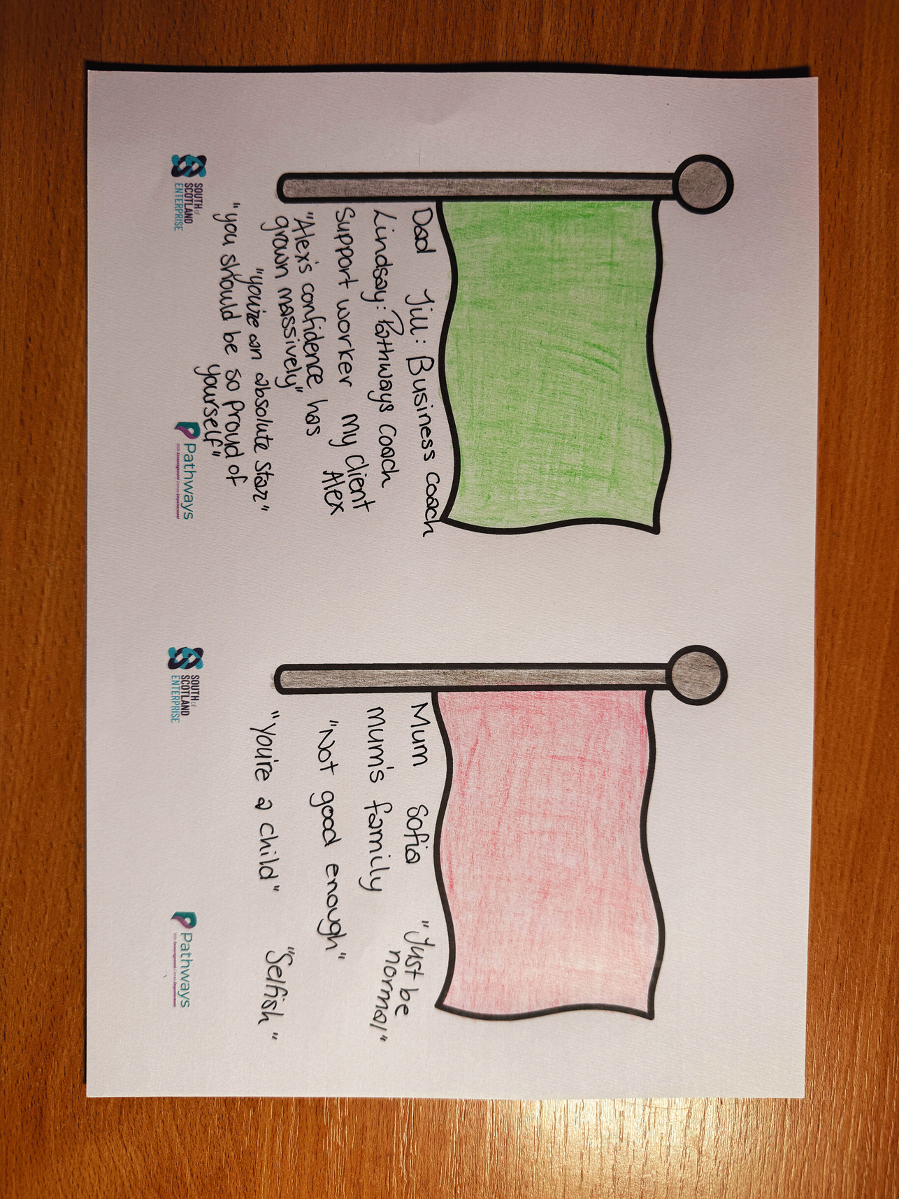
Vibe Check: Your Inner Circle
The Goal:
In business, your environment is everything. Some people fuel your fire; others try to put it out. To succeed, you need to know who belongs in your "front row" and who is a distraction.
Green Flags (The Accelerators):
  Who supports your vision even when it’s "just an idea"?
  What habits or mindsets keep you moving forward?
  Example: "Friends who celebrate my small wins."
Red Flags (The Brakes):
  Who makes you feel "small" or like you’re "doing too much"?
  What internal thoughts (like imposter syndrome) stop your progress?
  Example: "The 'friend' who only texts when they need a favor."
Image by: Kindling Minds
6

Slide 7



Community is your biggest support
Your Network is Your Greatest Asset
We can’t always choose our family, and that’s okay. You don’t need to rely solely on those closest to you to build something great. Sometimes, your biggest supporters are the people you meet along the way... mentors, peers, and experts who "get" the hustle.
The Reality Check: Community can be built from the ground up. In the South of Scotland, you have a ready-made squad waiting to help you turn your ideas into a reality.
Your Local Support Squad (D&G & The Borders)
If you are looking for your "Green Flag" team, these organisations are your first port of call:
  South of Scotland Enterprise (SOSE): A dedicated team focused on helping businesses in our region thrive. They provide the tools and guidance to help you scale.
  Business Gateway: Your local experts for practical, hands-on advice. Whether you’re just starting or ready to grow, their team is there to back you.
  Chamber of Commerce: A community of like-minded entrepreneurs right here in the South of Scotland. It’s the perfect place to meet peers who are facing the same challenges as you and get advice.
7

Slide 8
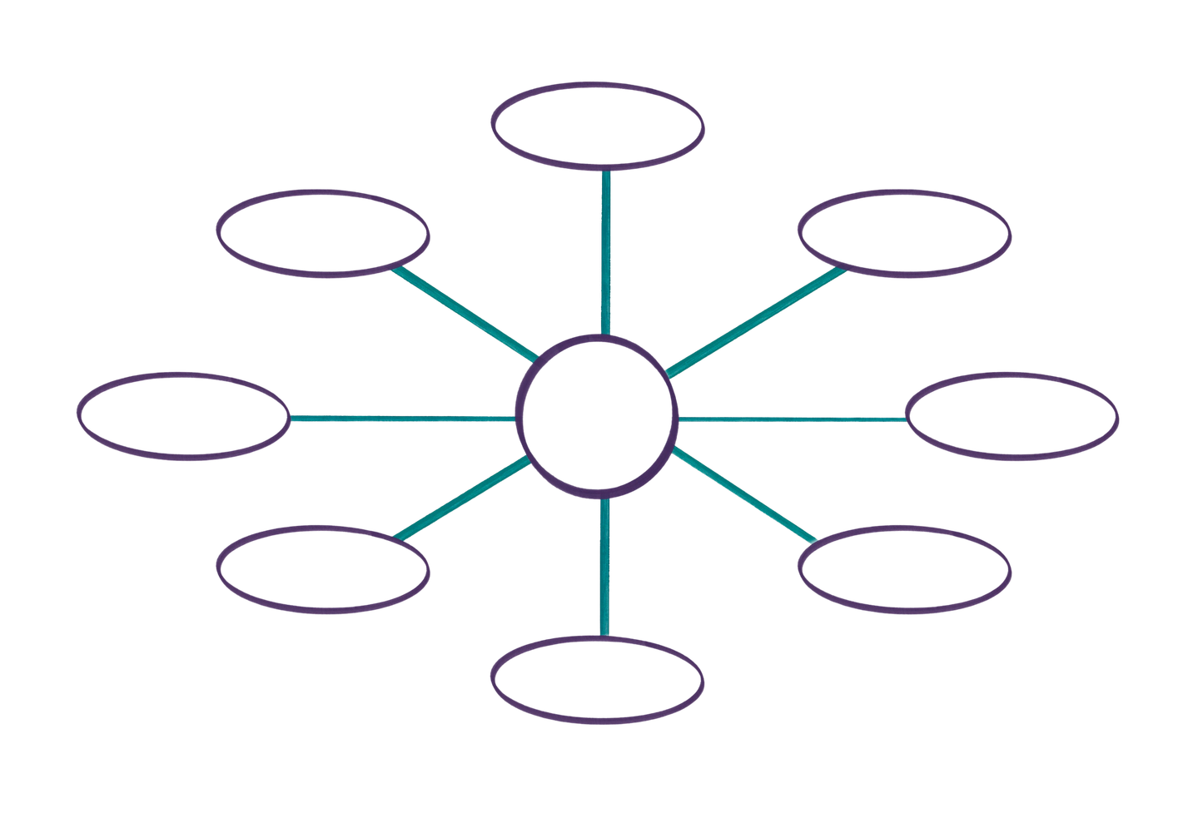
Creating your network
Try to name one person or organisation that you can go to if you need help or are struggling with failure...
Then around each name give an example to help you remember why you chose them!
She always reminds me how proud she is of me, even on the days I struggle to see it myself. She builds my confidence, lifts me up when things feel heavy, and is always there with kindness, encouragement, and support whenever I need it.
Example:
Jill
She always tells me how it is, no bs! She also reminds me that I am great at what I do, and we can always lean on each other when we need that extra support.
Is always there for me, no matter what I go through! Whether that’s emotionally or physically, she is there no matter what!
Kirsty
Victoria
She always reminds me that I am a strong and independent women and business owner!
My Network
Helps me to reason and supports me when I’m down! She also helps me to challenge the negative thought patterns that I struggle to overcome.
Vickie
Lindsay
Auntie Fiona
Dad
My biggest cheerleader. Through my difficult upbringing, she has always been there to console me, lift me up and cheer me on, no matter the distance.
He always takes time to learn about my health and brain, so he can support me better!
Tara
She is always there to answer questions, hype me up, and encourages me to do scary things!
8

Slide 9
Worst Case Scenario
We often let a vague "fear of failure" stop us from starting. But what does "failure" actually look like? Usually, it’s not a dead end... it’s just a detour. Let’s break down the "Big Scary Thing" into a plan.
The Three-Step Deconstruction
1. What is the worst that could happen? Be specific. Don't just say "it fails." What actually happens?
  Examples: I lose the £200 I invested; I launch a product and nobody buys it; I feel embarrassed because I told my friends I was starting a business.
2. And then what? Follow the trail. If that "worst thing" happens, what does the next day look like?
  Examples: I still have my part-time job; I still have my skills; I realise that most people are too busy with their own lives to notice mine.
3. If this happened… I would… This is your Recovery Plan. It turns a "fear" into a "procedure."
  Examples: I would ask my mentor at SOSE what went wrong; I would tweak my idea and try again; I would treat it as a "lesson fee" rather than a "loss."
9

Slide 10
Learning Objectives
Let’s Recap:
Understand that setbacks are a normal part of learning and growth
Explore thoughts and feelings that arise when things don’t go to plan
Identify supportive and unhelpful influences (green and red flags)
Learn strategies to respond to challenges and move forward
1
2
3
4
10

