Slide 1


Building Your Business
Module 9:
Using Social Media
Delivered by
1

Slide 2
Understanding opportunities, ideas and local entrepreneurship
This programme is about exploring ideas, building confidence and understanding how enterprise can create opportunities in the South of Scotland.
1
What is Pathways?
2
What will you gain?
3
Session Structure
The Pathways Programme by South of Scotland Enterprise (SOSE) is a support initiative designed to help people in the South of Scotland turn their business ideas into reality.
It specifically focuses on women and under-represented groups, helping them overcome the personal and practical barriers that often make starting a business feel overwhelming.
  Confidence & Coaching: Personal support from local coaches to help you move past self-doubt and build the resilience needed to run a business.
  Financial Help: Small grants (up to £1,000) to help pay for start-up essentials like equipment, marketing, or training.
  Community: Connection to a network of other local entrepreneurs so you don’t have to start your journey alone.
  Growth Support: Specialist coaching for those ready to scale up or innovate their existing business.
  Introduction video
  Understanding entrepreneurship
  Regional opportunities
  Case study
  Activity
  Reflection
  Key takeaways
2

Slide 3

Learning Objectives
By the end of this module you will:
1
Explore how businesses use digital tools to create, plan, and share content.
Understand what content strategy is and why planning helps businesses grow.
Identify digital tools such as Canva, AI, and social media platforms.
Create a simple content plan using digital tools to support business goals.
2
3
4
Image by: Canva Mockups
How will people find your business?
3

Slide 4

What apps do you use daily?
Think about what apps you use everyday on your phone, tablet or computer...
In your workbook list 3 apps you use daily and 5 other apps you have on your phone!
Top 3:
5 other apps:
Image by: Canva Mockups
4

Slide 5
Why social media matters
In 2026, social media isn't just for sharing what you had for lunch. It’s the digital front door to your business. Whether you’re selling handmade crafts in Dumfries or running a community garden in Galashiels, if you aren't on their screen, you don't exist in their world.
The "Gen Z" View: Personal Brand & Creative Impact
  The Search Engine of the Future: Most young people don't use Google anymore; they search TikTok and Instagram. If a tourist is looking for "cool things to do in the Borders," your business needs to be the top video they see.
  Authenticity > Perfection: You don’t need a Hollywood budget. People love "lo-fi" content. Behind-the-scenes clips of you building your project, are more powerful than a shiny advert!
  Social for Good: If your business is "Selfless" (socially focused), social media is how you find your "tribe"! The people who care about the same causes you do!
5

Slide 6
Why social media matters
Social Media helps businesses to get noticed, build trust, connect with customers and grow their client base!
The "Pro" View: Strategy, AI, & Conversion
  AI as Your Co-Pilot: Using AI tools can help you script videos or analyse what time your followers are most active. It’s like having a free marketing team in your pocket.
  The "Dark Social" Secret: Building communities in private spaces like WhatsApp Channels or DMs is where the real trust is built. It’s where casual followers become loyal customers.
  Social Search (SEO): Video’s need captions! Optimising your captions with local keywords (like "South of Scotland startup" or "Dumfries & Galloway eco-shop") ensures the right people find you at the right time.
6

Slide 7
Why it matters specifically for the South of Scotland?
"Rural doesn't mean unreachable."
In a beautiful but spread-out region like ours, social media is the "great equaliser." It allows a small business in remote areas to compete with a massive brand in Edinburgh, London and even the U.S.
Benefit | What it looks like in the South of Scotland:
Visability | A farm shop in Kelso getting orders form customers in Glasgow or Manchester.
Community | A youth group in Stranaer finding volunteers via an Instagram reel.
Tourism | A local bike trail becoming viral and bringing visitors to local cafés and towns (like Glentress in Peebles).
Feedback | Using a pole on your story to let locals decide what your next product is or give ideas as to what their next product should be.
Running a business doesn't mean you need to be a tech genius. It means knowing which "Digital Co-pilots" to use so you can focus on your passion and stay organised (Module 8).
7

Slide 8
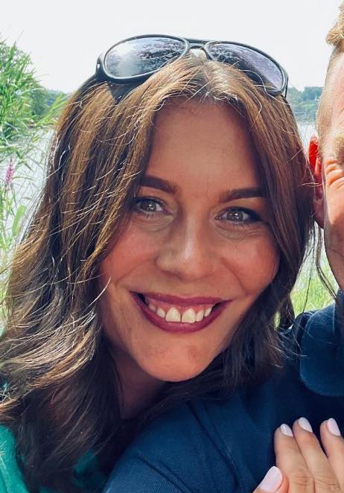
Goal Setting
What would you like success to look like?
You can't reach the finish line if you don't know where the hurdles are.
Identifying what’s stopping you, allows you to set your target, and own your success!
Jill Millar (SOSE Business Coach)
 | What it means | South of Scotland Context
B - Blockers | What is stopping you right now? | Do you have slow Wi-Fi? Is there no transport to get you into town? Do you not know where to start? Do you struggle with your confidence?
O - Oppertunities | Where is the ‘open door’? | Is there a local festival coming up? Is there an empty shop in town? Is there a gap in the market for a new service?
S - Strengths | What are you already great at? | Are you a TikTok pro? Do you know everyone in your village? Are you brilliant at making things?
S - Situations | What is happening around you? | Is it tourist season? Is the local community looking for more eco-friendly options? Is your business idea something that your community hasn't seen but desperately needs?
Method created by: Jill Millar (SOSE Business Coach)
8

Slide 9
Goal Setting
What is one goal you have for your business idea?
  Get a set number of customers?
  Share the work you are doing
  Building confidence?
  Sell a product?
In your workbook, finish this sentence:
My first business goal is...
9

Slide 10
Level Up Your Strategy: The SMART Way
Think of a SMART target as the "cheat code" for your business. Without them, you’re just posting into the void and hoping for the best. With them, you actually know if your social media is working or just wasting your screen time.
What does SMART actually mean?
S- Specific: No "I want to be famous." Instead, try "I want 500 new followers on TikTok."
M- Measurable: How do you track it? (Likes, shares, sales, or website clicks).
A- Achievable: Be real. You probably won't hit 1 million followers by Tuesday if you have 10 today.
R- Relevant: Does this help your business? Getting 1k likes on a cat video is cool, but if you sell shoes, did anyone actually look at the shoes?
T- Time-bound: Give yourself a deadline. "By the end of next month."
10

Slide 11
Why bother? (The ‘So What?’)
Feature | Why it matters to you?
Clarity | You stop guessing what to post and start acting with purpose.
Motivation | Small wins keep the ‘burnout’ away.
Evidence | You can prove to yourself that your time on social media is actually making money or having an impact. This is key if applying to funding for the business!
The Vague Idea: "I want more people to sign up for my workshops using Instagram."
The SMART Version:
"To grow Kindling Minds, I will generate 20 new sign-ups for the 'Mindset Reset' workshop by May 31st by posting 3 high-value Reels per week that drive traffic to the 'link in bio' registration page."
11

Slide 12
Create your next social media post:
Task: Design a post that helps you achieve your business goal.
You can:
✏️ Draw it on paper
💻 Create it on a device
Your post must include:
• A Hook – What will grab attention?
• An Image – What will people see?
• A Caption – What are you saying?
• A Call to Action (CTA) – What do you want people to do?
Make sure your post links to the goal you set in task 5.
12
Image taken from: SOSE Instagram

Slide 13

Learning Objectives
Let’s Recap:
1
Explore how businesses use digital tools to create, plan, and share content.
Understand what content strategy is and why planning helps businesses grow.
Identify digital tools such as Canva, AI, and social media platforms.
Create a simple content plan using digital tools to support business goals.
2
3
4
Image by: Canva Mockups
13

