Slide 1


Business Reality
Module 14:
Starting your Business - Our Top Tips
Top Tips from Young Entrepreneurs and Advice from Experienced Business Owners Across the South of Scotland
Delivered by
1

Slide 2
Learning Objectives
By the end of this module you will:
1
Learn from real experiences of young entrepreneurs and business owners
Explore common challenges and mistakes when starting a business
Reflect on what may be holding you back from taking action
Create a simple, realistic action plan for your next steps
2
3
4
What do you think business owners in the South of Scotland would tell you?
2

Slide 3
Tips from Successful Business Owners in the South of Scotland
3
Notes:
Video embedded

Slide 4
Remember...
Starting a business can feel:
• Exciting
• Complicated
• Overwhelming
But you don’t need to know everything to start.
What feels hardest about starting or moving forward?
Challenges and Mistakes Young Entrepreneurs Have Made
4
Notes:
Video embedded

Slide 5
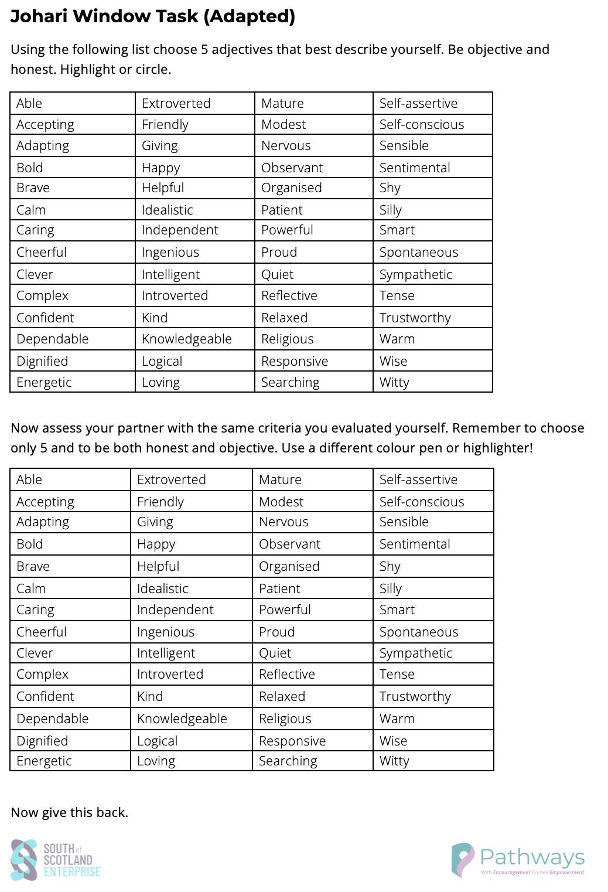
Johari Window Task
Find a partner that you don’t know very well!
This next task is to understand what you think about yourself, and what others think about you (spoiler, you are likely far more critical than other people!).
5

Slide 6

Ideas are great… but action is what moves you forward
What is one idea you want to act on?
My idea is:
My goal is:
My first step will be:
I will do this by:
Something that might challenge me:
How I will manage this:
Remember: You are not alone, there are people, businesses, and support around you.
6

Slide 7
Learning Objectives
Let’s Reflect:
1
Learn from real experiences of young entrepreneurs and business owners
Explore common challenges and mistakes when starting a business
Reflect on what may be holding you back from taking action
Create a simple, realistic action plan for your next steps
2
3
4
Task 12: One word that describes how I now feel about starting my own business:
7

