Slide 1


Understanding your Idea
Module 4:
Understanding Your Customer
Who is your idea really for?
Delivered by
1

Slide 2
Understanding opportunities, ideas and local entrepreneurship
This programme is about exploring ideas, building confidence and understanding how enterprise can create opportunities in the South of Scotland.
1
What is Pathways?
2
What will you gain?
3
Session Structure
The Pathways Programme by South of Scotland Enterprise (SOSE) is a support initiative designed to help people in the South of Scotland turn their business ideas into reality.
It specifically focuses on women and under-represented groups, helping them overcome the personal and practical barriers that often make starting a business feel overwhelming.
  Confidence & Coaching: Personal support from local coaches to help you move past self-doubt and build the resilience needed to run a business.
  Financial Help: Small grants (up to £1,000) to help pay for start-up essentials like equipment, marketing, or training.
  Community: Connection to a network of other local entrepreneurs so you don’t have to start your journey alone.
  Growth Support: Specialist coaching for those ready to scale up or innovate their existing business.
  Introduction video
  Understanding entrepreneurship
  Regional opportunities
  Case study
  Activity
  Reflection
  Key takeaways
2

Slide 3

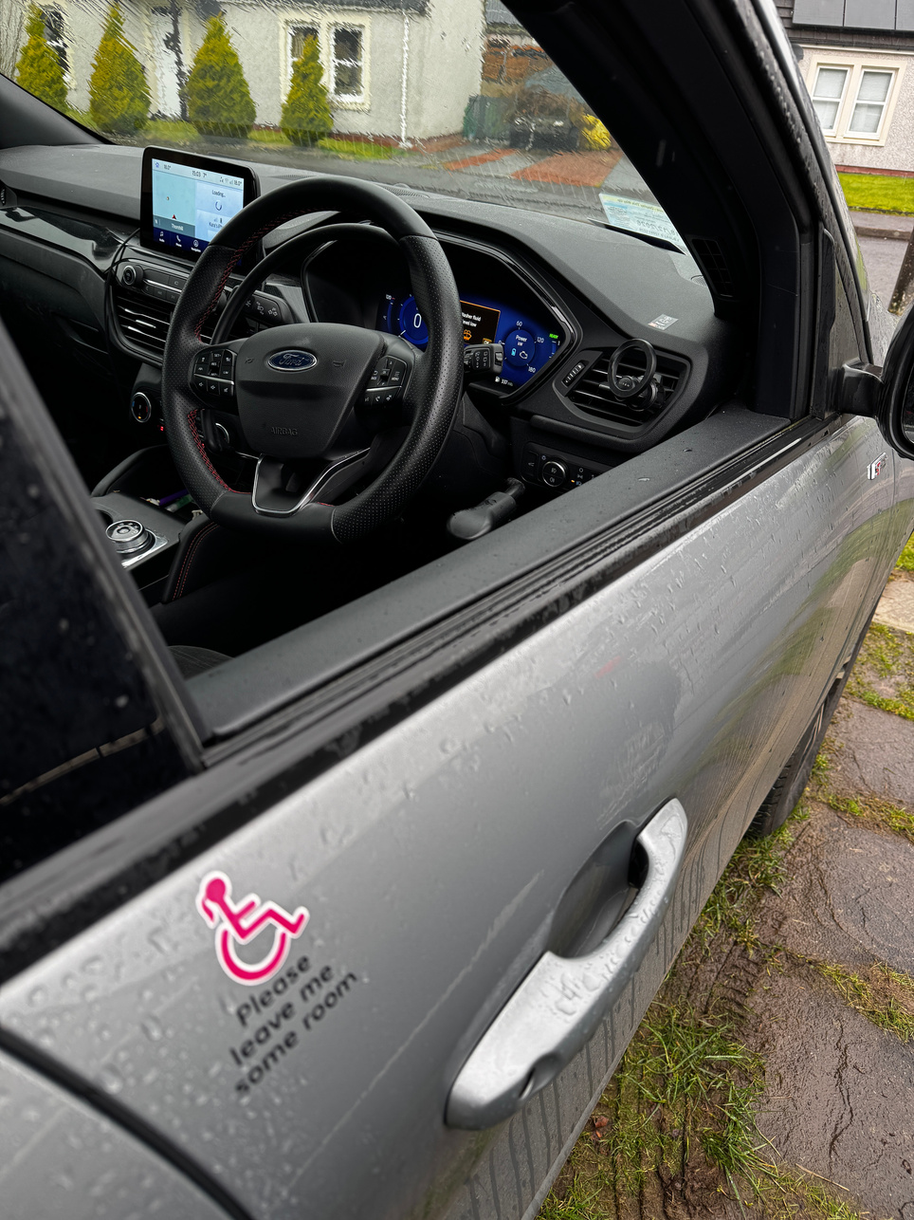
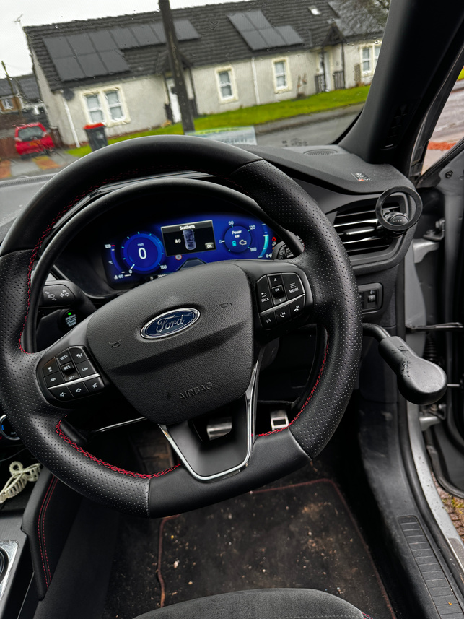

Heated Blanket
Learning Objectives
Adapted Car
By the end of this module, you will:
1
Learn why knowing your customer is key to building a successful idea
Identify who a product or service is designed for
Explore the connection between problems, needs, and solutions
Begin thinking about your ideal customer and their experiences
2
Image from: www.cosihome.com
Birthday Cake
3
4
Image by: Kara Hunter
Image from: www.seriouseats.com
Who do you think these products are for?
3

Slide 4

Your Business isn’t for Everyone
A successful business doesn’t try to sell to everyone!
It focuses on the people who actually need it!
Consider a dog walking service.
  Who is the customer?
  What problem are they solving?
  What was their solution?
Image by: Canva AI
Businesses succeed when they understand their customers well!
  Complete task 3 and 4
4

Slide 5
Your customers
Think about your business idea. If you don’t have one, think of a local business near you.
We’re going to describe your ideal customer!
Think about the following:
  Age
  Lifestyle
  Needs
  Situation
  Struggles
  Day-to-day living
On your workbook you have a stick person like the one here.
In your workbook, jot down ideas on who your ideal customer is, and why they are your ideal customer.
5

Slide 6
Case Study
While watching the case study, takes notes on who their customer is, what problem do they solve, and what did they do to gain a bigger audience?
6

Slide 7
Research, Insights and Analytics
How do businesses make strategic changes?
In a world where every click, purchase, and complaint is recorded, businesses are often "data rich but insight poor."
Imagine you’re running a clothing brand and sales suddenly tank. You could just guess and change the colours of your hoodies, but that’s a huge risk. Instead, you use the "Big Three"
Analytics
Research
Insights
(the numbers)
(the detective work)
(the ‘aha’ moment)
This is like checking your "Screen Time" or your post reach.
The Business Version: You look at the data and see that 80% of people put an item in their cart but leave the site before buying.
The Takeaway: You now know where the problem is, even if you don’t know why yet.
Now you ask questions. You send out a poll or look at comments.
The Discovery: You find out customers think your checkout page looks sketchy or takes too long to load on a phone.
The Takeaway: You’ve found the "hidden" problem that the numbers couldn't explain on their own.
This is where you connect the dots.
The Realisation: "Our customers are Gen Z; they want to pay with Apple Pay or PayPal in one click. They aren't going to go find a physical credit card to type in 16 digits."
The Result: That is an insight. It’s the truth behind the data.
7

Slide 8

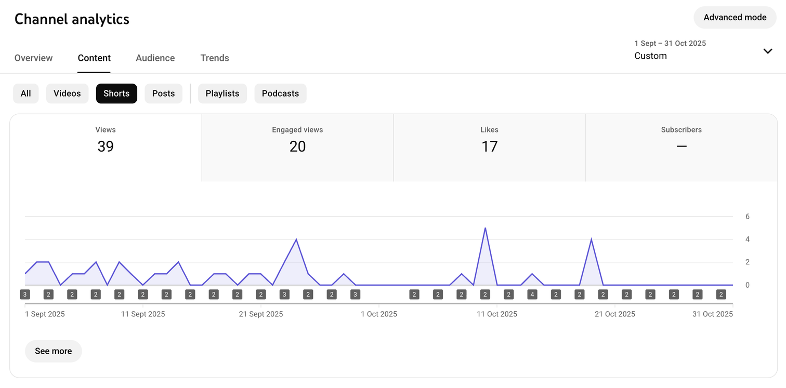
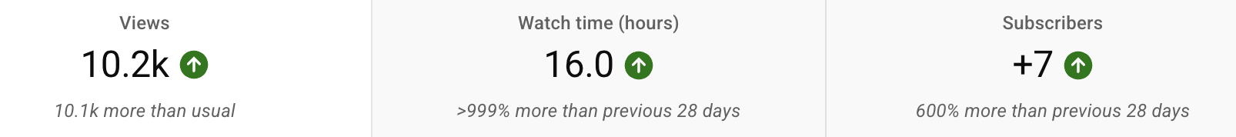
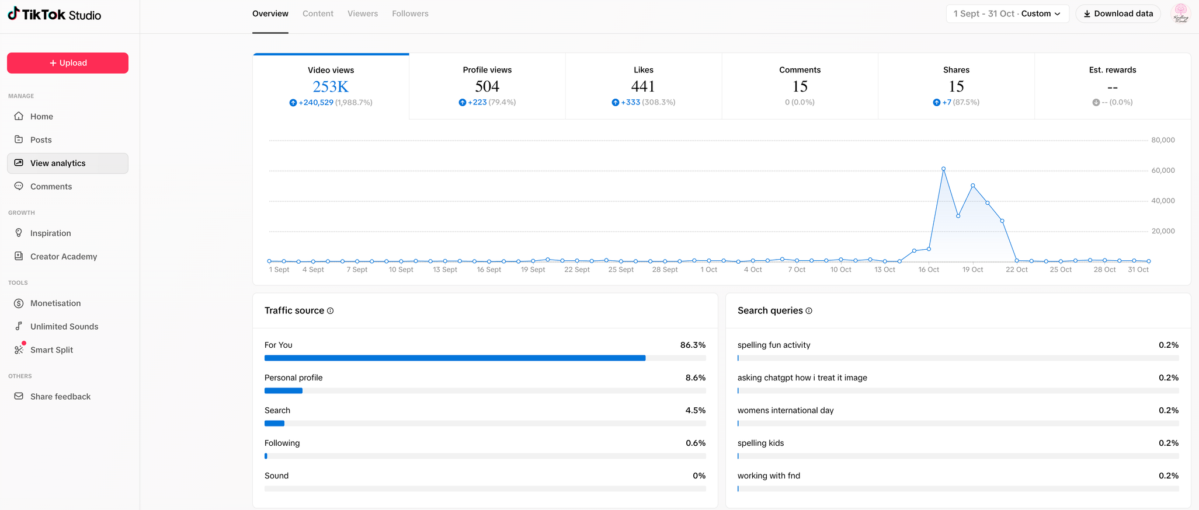
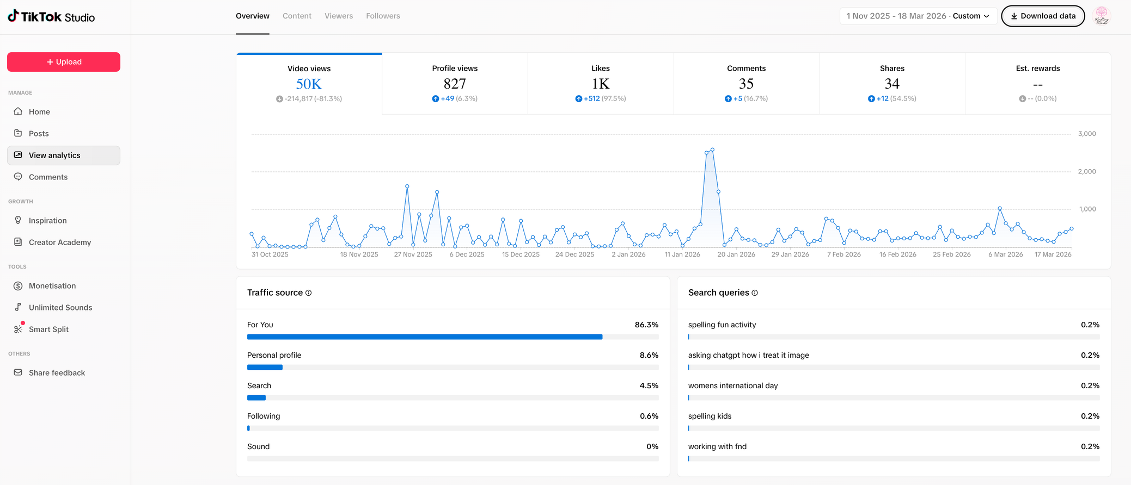
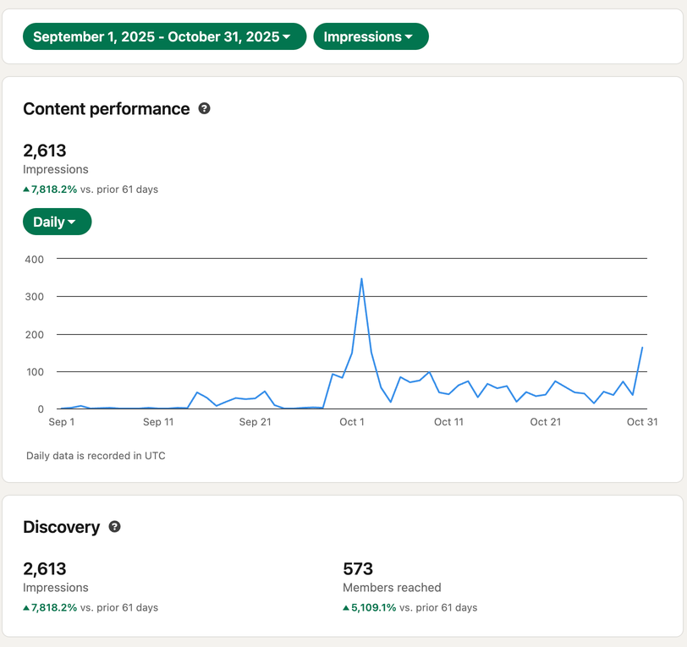
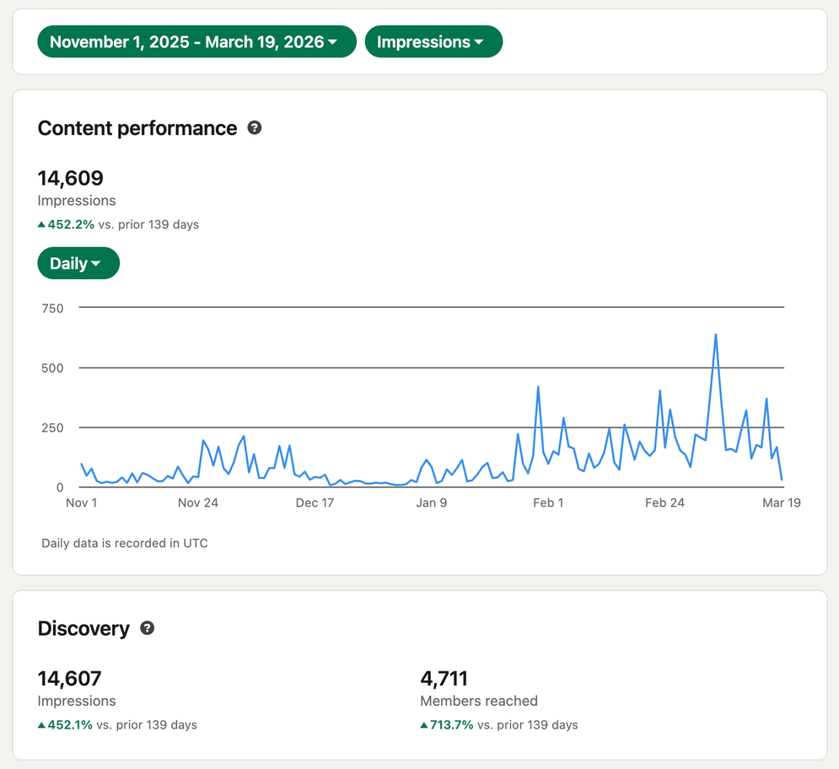
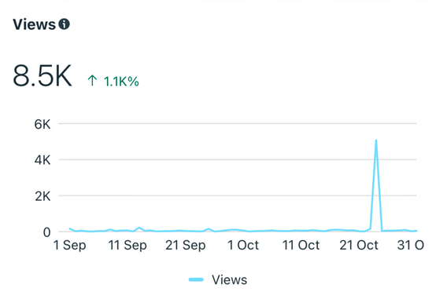
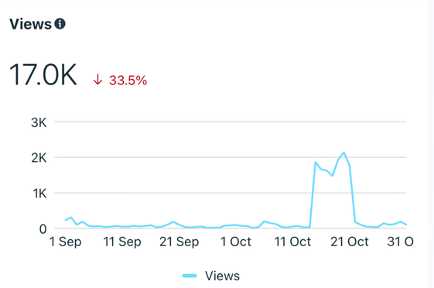
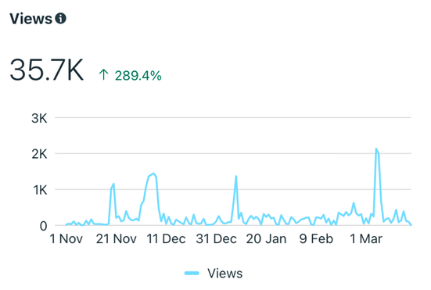
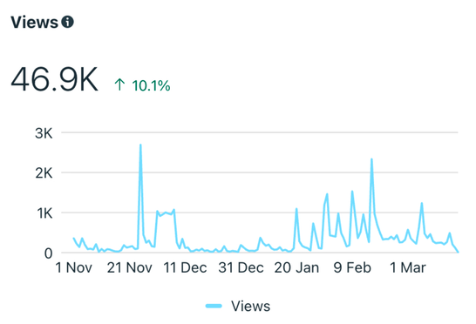
Analytics Deep Dive Activity
Below is real data from two points in Kindling Minds business journey
End of Month 2
End of Month 6
Youtube:
Youtube:
TikTok:
TikTok:
Linked In:
Linked In:
Instagram:
Facebook:
Instagram:
Facebook:
8

Slide 9
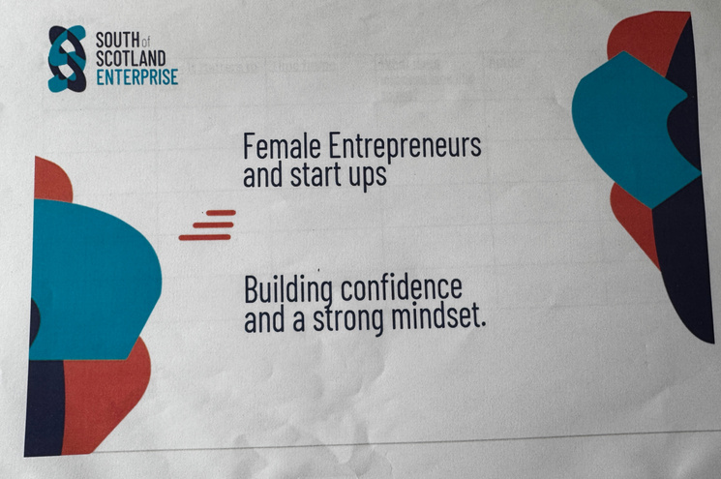
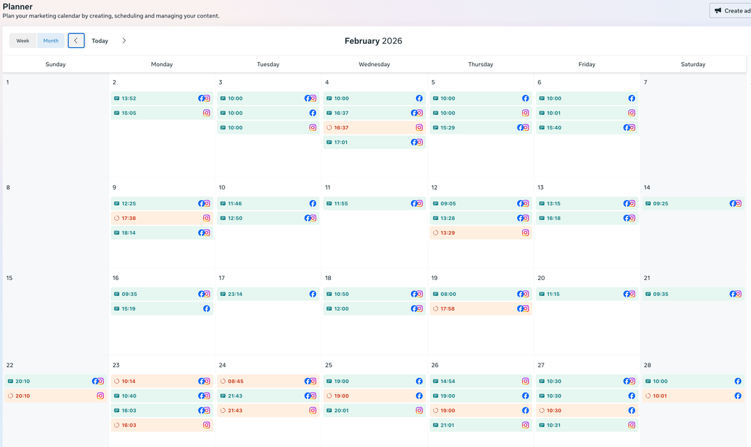
Business Timeline
Look at the timeline below. It shows the businesses journey and what they did to grow their audience and engagement.
17-Sep-25
Kirsty came to a session and said:
“Just post it! The more you post, the less scary it becomes”
01-Sep-25
I went on another SOSE run workshop ‘Marketing Bootcamp’
03-Dec-25
Started posting 7 days a week, filmed in batches, and have the occasional double or triple upload days.
Aug-25
I went on my first SOSE workshop with Jill and Tara
I used canva to create social media post ideas
I set myself the goal of posting 3 times a week.
Contacted Business gateway D&G
Concept: July ‘25
Today:
Mar ‘26
They recommended I contact SOSE.
I identified my customers and what social media platforms I use
I was too scared to post any face videos
I started to post face-to-camera videos adhocly
19-Nov-25
They discussed the importance of face-to-camera videos, using a microphone and posting regularly with a content planner.
04-Feb-26
Went to the Pathways Expo Event and was advised to post multiple times a day, 7 days a week
I look at my analytics before I batch film. I also look at content gaps and insight trends on each platform before filming.
I also look at when my customers are online and schedule posts at different times each day depending on active times per platform.
I also now film all content as face-to-face videos and I ask my audience what they would like to see and make content around their interests and pain points.
9

Slide 10
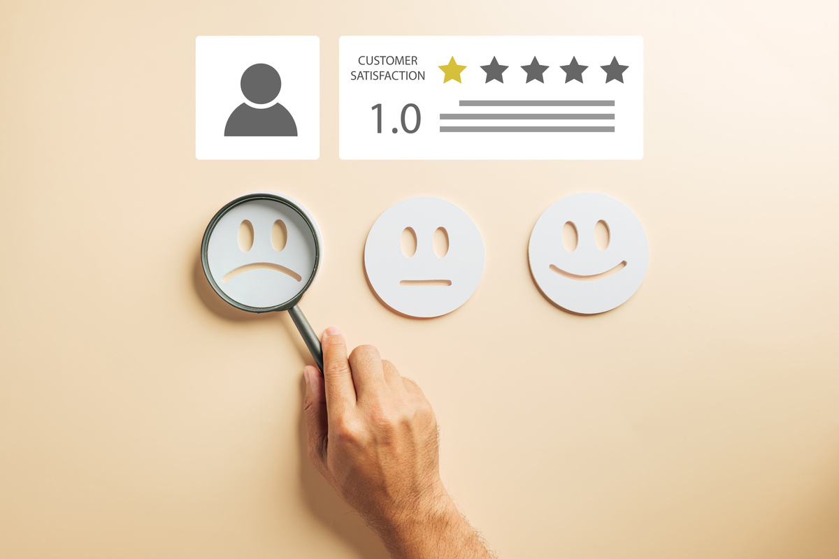
Learning Objectives
Let’s Recap:
1
Learn why knowing your customer is key to building a successful idea
Identify who a product or service is designed for
Explore the connection between problems, needs, and solutions
Begin thinking about your ideal customer and their experiences
2
3
4
10

