Slide 1


Building Your Business
Module 5:
Responsible Business & Event Design
What is fair work, accessibility and responsible entrepreneurship?
Delivered by
1

Slide 2
Understanding opportunities, ideas and local entrepreneurship
This programme is about exploring ideas, building confidence and understanding how enterprise can create opportunities in the South of Scotland.
1
What is Pathways?
2
What will you gain?
3
Session Structure
The Pathways Programme by South of Scotland Enterprise (SOSE) is a support initiative designed to help people in the South of Scotland turn their business ideas into reality.
It specifically focuses on women and under-represented groups, helping them overcome the personal and practical barriers that often make starting a business feel overwhelming.
  Confidence & Coaching: Personal support from local coaches to help you move past self-doubt and build the resilience needed to run a business.
  Financial Help: Small grants (up to £1,000) to help pay for start-up essentials like equipment, marketing, or training.
  Community: Connection to a network of other local entrepreneurs so you don’t have to start your journey alone.
  Growth Support: Specialist coaching for those ready to scale up or innovate their existing business.
  Introduction video
  Understanding entrepreneurship
  Regional opportunities
  Case study
  Activity
  Reflection
  Key takeaways
2

Slide 3
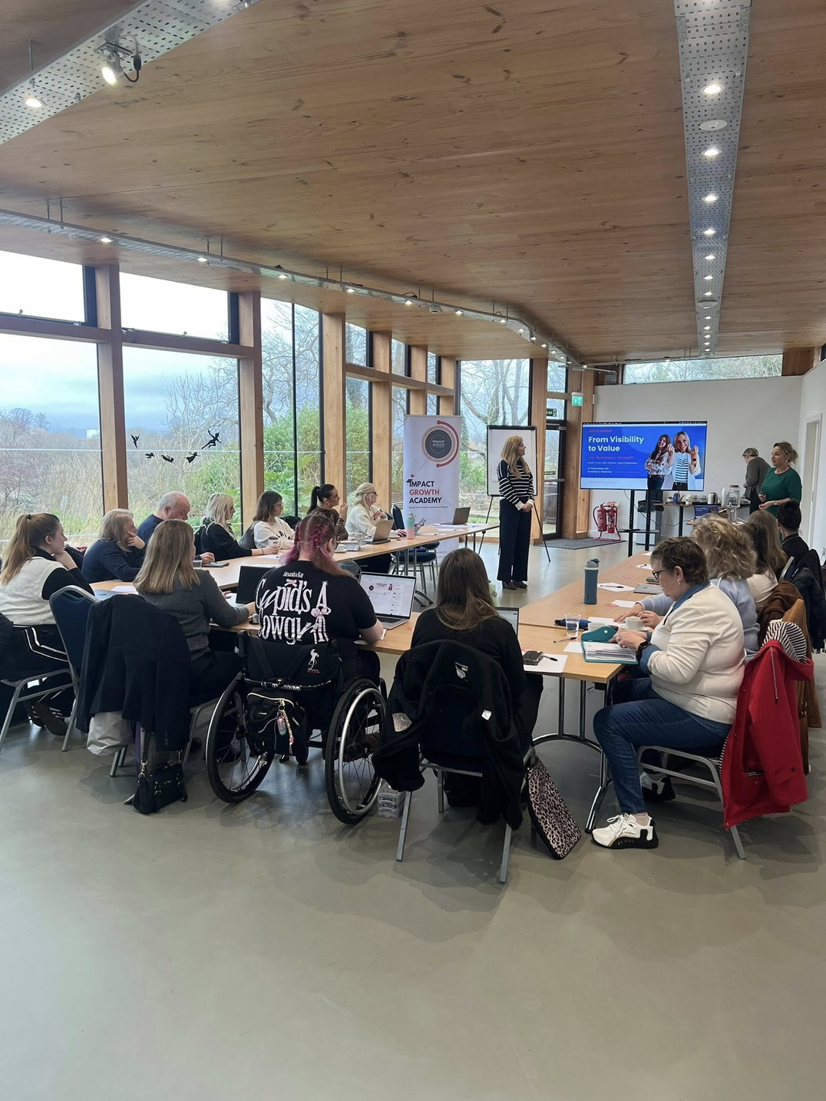
Learning Objectives
By the end of this module you will:
1
Understand the importance of fair work, accessibility, and inclusion
Explore how different people experience businesses and environments
Identify barriers that may impact others
Learn how small changes can create more inclusive and supportive spaces
2
3
4
Image from: DG Chamber of Commerce
Discuss: Do you think events or businesses are usually accessible for everyone?
3

Slide 4
Key Definitions
Fair Work means:
Creating workplaces where employees feel:
• respected
• secure
• valued
• fairly paid
• able to contribute ideas
Accessibility means:
Designing spaces, services, and opportunities so everyone can participate.
This might include:
• physical access
• communication access
• sensory environments
• flexible participation options
Inclusion means:
Designing environments where people feel welcome, valued, and able to participate.
4

Slide 5
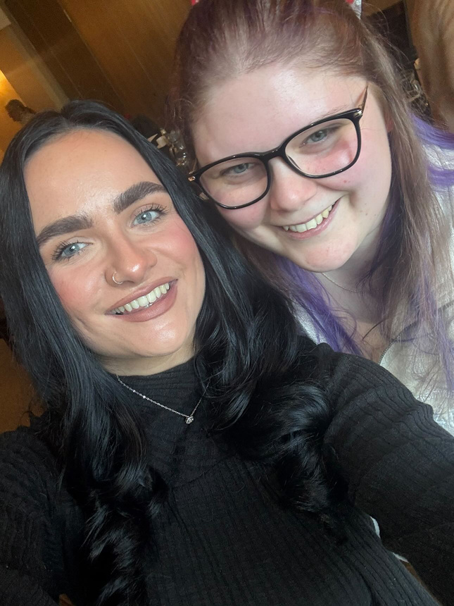
Video Comparison
While watching the following two videos think about:
• What barriers do you notice?
• What choices made things easier or harder?
• Who has time to do things they enjoy?
5

Slide 6

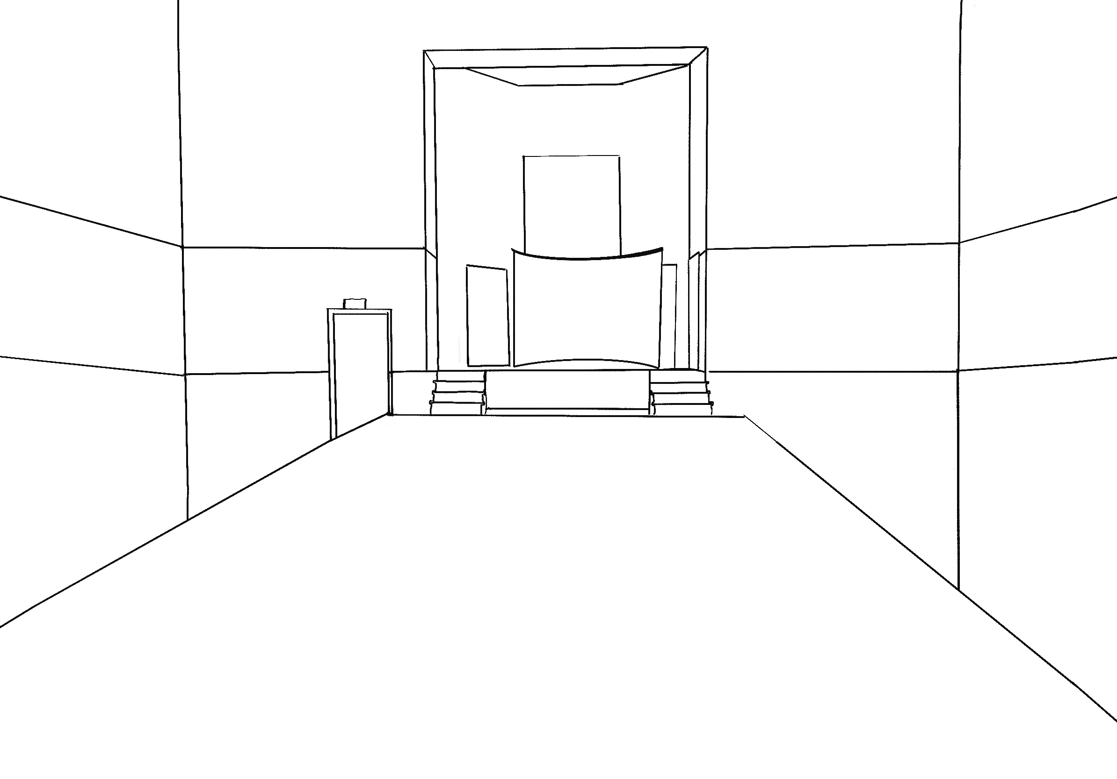
Scenarios | A Real Example:
SOSE’s Pathways Expo Event | February 2026
What barriers do you think Kara had during the event? Did Kirsty have any barriers?
Transcript:
The centre of the room was filled with tables set out in groups of four, taking up most of the main space. Upstairs, there were professional headshots being taken, alongside a podcast room where people could record reflections from the day.
On either side of the central area, there were rows of stools, and participants could move around freely to explore everything happening. Along the right-hand side, there were social media experts and industry leaders, covering everything from LinkedIn to wider business growth, as well as support from Business Gateway, Chamber of Commerce D&G and SOSE.
On the other side, there were stands from people who had been part of the Pathways programme over the past 12 months, all showcasing what they had been working on and building thanks to Pathways.
Because the space was quite tight, it did feel a little busy at times, especially with people moving between the main floor, the headshot area, and up towards the stage, and all of the stalls.
6

Slide 7
Scenario 1
Scenario 2
Scenario 3
Community Festival
Networking Event
Workshop
A group of young entrepreneurs are planning a community festival. They need volunteers to help run the event.
They advertise the roles as:
  “Great opportunity for confident people.”
  “Must be available all weekend.”
  “Unpaid – great experience for your CV.”
  “Fast-paced environment – must be able to stand for long periods.”
On the day of interviews, they only choose people they already know from school and local clubs. No travel expenses are offered. There is no clear explanation of roles or breaks.
A new business is hosting a networking evening for young entrepreneurs.
The format is:
  Loud music playing in the background.
  A 2-minute speed-networking rotation.
  Everyone stands in the middle of the room.
  No quiet space.
  The event is promoted as “for bold and outgoing people.”
There is no mention of alternative ways to participate or communicate.
A youth enterprise workshop is being held in a popular community hall.
The organisers checked:
✔ It has a disabled toilet.
✔ It has parking outside.
✔ It has wide doors.
However:
  The workshop activities are set up upstairs with no lift.
  The accessible toilet door is heavy and hard to close independently.
  Presentation slides are not shared in advance.
  There are no subtitles on the video clips.
The organisers believe they have “covered accessibility.”
7

Slide 8
Independent Task:
Event Options (Choose One)
  Charity Fundraising Event
  Gaming or Esports Event
  Health & Wellbeing Workshop
  Outdoor Adventure Day
  Cultural Celebration Event
  College or University Open Day
  Job Interview / Recruitment Event
  Social Event (e.g. disco, movie night, youth club)
  School Careers Event
  Youth Networking Event
  Community Festival
  Music or Arts Event
  Sports Tournament or Activity Day
  Business Start-Up Workshop
  Pop-Up Market or Local Business Fair
8

Slide 9
Learning Objectives
Let’s Recap:
1
Understand the importance of fair work, accessibility, and inclusion
Explore how different people experience businesses and environments
Identify barriers that may impact others
Learn how small changes can create more inclusive and supportive spaces
2
3
Image from: DG Chamber of Commerce
4
9

