Slide 1


Business Reality
Module 11:
Understanding Cost, Pricing and Profit
Delivered by
1

Slide 2
Understanding opportunities, ideas and local entrepreneurship
This programme is about exploring ideas, building confidence and understanding how enterprise can create opportunities in the South of Scotland.
1
What is Pathways?
2
What will you gain?
3
Session Structure
The Pathways Programme by South of Scotland Enterprise (SOSE) is a support initiative designed to help people in the South of Scotland turn their business ideas into reality.
It specifically focuses on women and under-represented groups, helping them overcome the personal and practical barriers that often make starting a business feel overwhelming.
  Confidence & Coaching: Personal support from local coaches to help you move past self-doubt and build the resilience needed to run a business.
  Financial Help: Small grants (up to £1,000) to help pay for start-up essentials like equipment, marketing, or training.
  Community: Connection to a network of other local entrepreneurs so you don’t have to start your journey alone.
  Growth Support: Specialist coaching for those ready to scale up or innovate their existing business.
  Introduction video
  Understanding entrepreneurship
  Regional opportunities
  Case study
  Activity
  Reflection
  Key takeaways
2

Slide 3
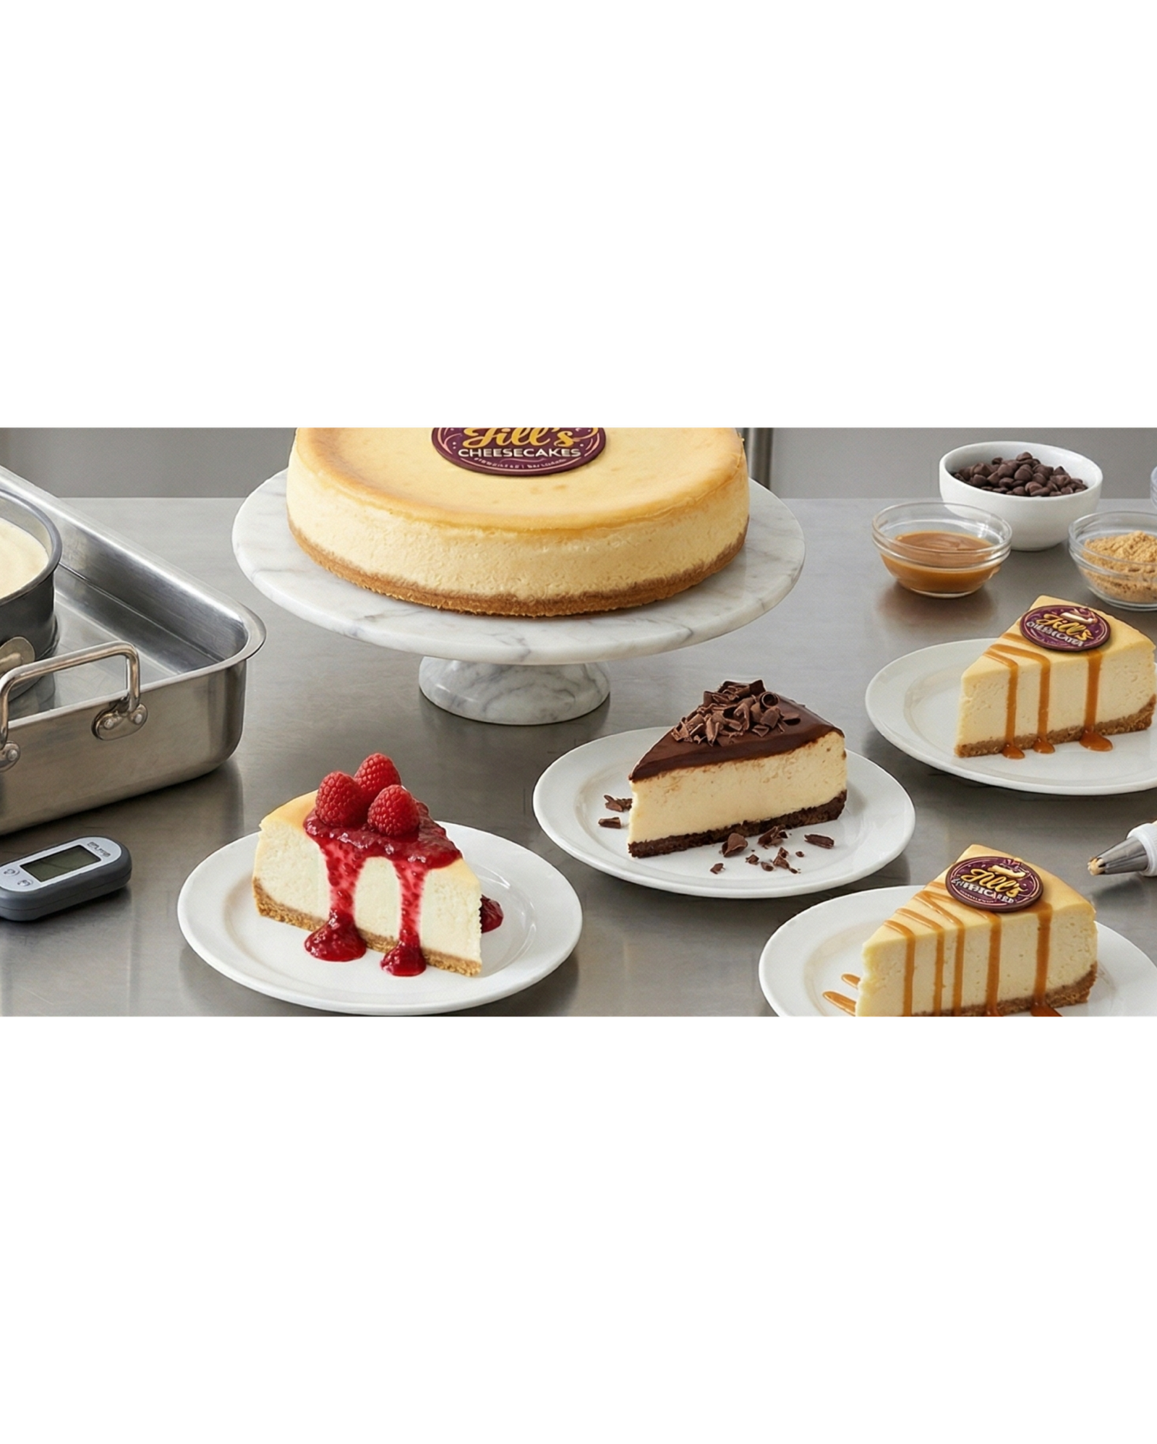

Learning Objectives
By the end of this module you will:
1
Understand how money works in a business, including value, costs, and profit
Learn how to identify costs and set realistic pricing
Explore what makes a product or service valuable
Begin applying simple calculations to your own business ideas
2
3
4
If you sell something for £10, do you make a £10 profit?
3

Slide 4

Jill’s Cheesecakes!
4
Notes:
Video embedded

Slide 5

What makes something valuable?
List 3 things that make a product or service valuable.
Think about:
  Quality
  Time saved
  Convenience
  Experience
Image by: Canva AI
Does value mean the same to everyone?
5

Slide 6
Costs, Price and Profit
Match the name to it’s description
Cost
Price
Profit
is the total amount of money you spend to make your product or service a reality, including everything from raw materials and packaging to the value of your own time.
is the specific figure you choose to charge your customers, the actual amount of money they hand over to you when they make a purchase.
is the "keepable" money left in your pocket; it is the "win" you get once you subtract your total costs from your price
6

Slide 7
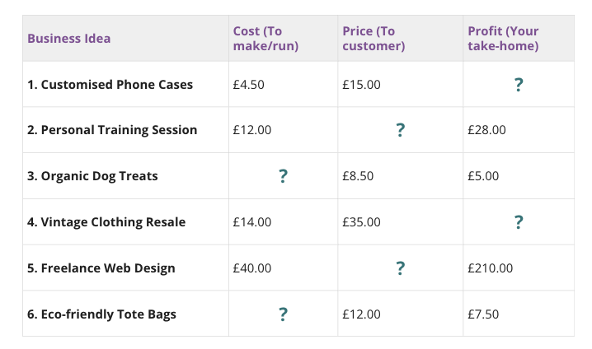
The Pricing Challenge
To run a successful business, you need to be able to find the "missing piece" of the puzzle. Use the formula below to solve the scenarios in the table.
The Golden Rules:
  To find Profit: Price - Cost = Profit
  To find Price: Cost + Profit = Price
  To find Cost: Price - Profit = Cost
7

Slide 8

Your business idea
Think about your business idea, and similar business in your area. You are now going to work out your own costs. To do this, ask yourself the following questions:
What are your costs?
• Materials
• Time
• Marketing
• Other
How much does your competitor charge?
Do you have any special skills that you could charge more for?
What would you charge?
What would your profit be?
Example:
I have specialised skills in primary teaching, P.E teaching and neurodiversity. I have 2 degrees, and one of those has a published paper on dyslexia. I also have lived experience. My competitor charges: £36 per session but it is group sessions only and only covers literacy and numeracy. I focus on 1:1 support in all areas of the curriculum, and personalised support. I charge £100 p/h. As a teacher I would be paid £23.84 p/h but I have to teach to 30 children. I have to make resources for each session which costs: £3 per session. I can then sell these resources online. I think I have a profit of £97.
8

Slide 9
Learning Objectives
Let’s Recap:
1
Understand how money works in a business, including value, costs, and profit
Learn how to identify costs and set realistic pricing
Explore what makes a product or service valuable
Begin applying simple calculations to your own business ideas
2
3
4
9

